Slide 1
Officer in Charge (OIC) Reference Guide
The Office of Alcohol Testing (OAT)

Slide 2
The Office of Alcohol Testing
124 Acton Street
Maynard, MA 01754
Main Number: (857) 377-3030
FAX: (857) 377-3035
Email:
POL-DL-OAT@massmail.state.ma.us
ENTRANCE TO THE BUILDING
  Call ahead to ensure OAT personal will be present
  Parking Lot is behind the building
  Ring the buzzer or call the main line to notify an OAT member you have arrived
DIRECTIONS FROM ROUTE 2
  Take Exit 42: MA-27 Maynard/Acton
  Head right onto MA-27S
  Follow MA-27S for approximately 2 miles
  Turn right onto Acton Street
  Turn right after housing community
DIRCTIONS FROM ROUTE 495
  Take Exit 27: MA-117 Bolton/Stow
  Turn left onto MA-117E
  Turn left onto Pompositticut Street
  Continue onto Summer Street
  Turn Left onto Concord Street
  Turn Left onto Acton Street
  Grey Commercial building on the left

Slide 3
The Office of Alcohol Testing
Staff List
Kristen Sullivan, Director (978) 451-3406
kristen.sullivan@massmail.state.ma.us
Melissa C. O’Meara, Forensic Scientist V (857) 377-3032 Office
melissa.o’meara@massmail.state.ma.us (978) 440-0590 Cell
Stacy Czarnowski, Forensic Scientist III (857) 377-3033
stacy.czarnowski@massmail.state.ma.us
Samantha V. Fisk, Forensic Scientist II (857) 377-3036
samantha.fisk@massmail.state.ma.us
Daniel J. Renczkowski, Forensic Scientist II (857) 377-3037
daniel.renczkowski@massmail.state.ma.us
Justin Kaliszewski, Forensic Scientist I (857) 377-3038
justin.kaliszewski@pol.state.ma.us
Michelle Dumas, Program Coordinator I (857) 377-3034
michelle.dumas@massmail.state.ma.us

Slide 4
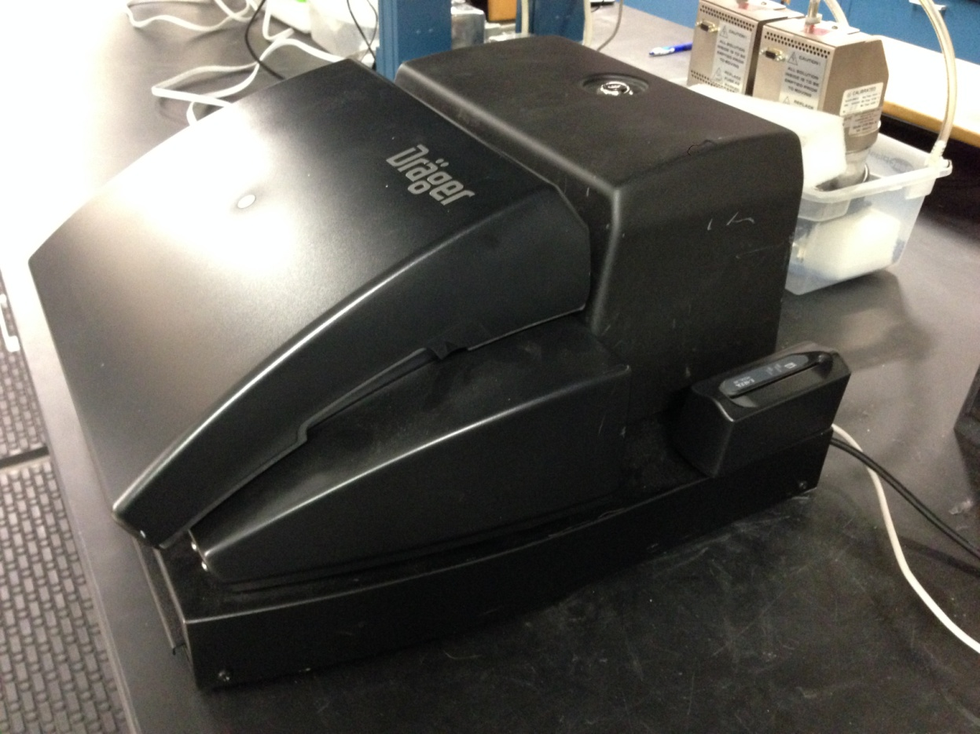
Draeger Alcotest 9510
Also known as:
Breathalyzer, BT, Breath Tester,
Instrument, Breath Test Device

Slide 5

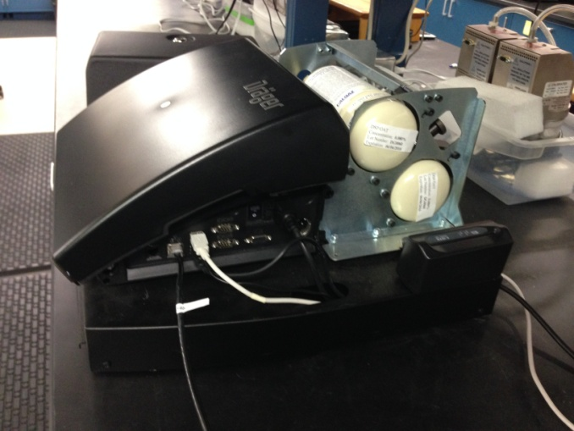
Draeger Alcotest 9510
The Covers
Key is Universal
Dry Gas Enclosure Cover
Dust Cover or
Top Cover
Side Cover

Slide 6
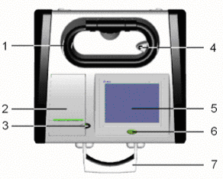
Draeger Alcotest 9510
Instrument Layout
1) Heated and temperature controlled breath hose in compartment
2) Cover of internal printer compartment
5) Color LCD touch screen
6) Start button

Slide 7
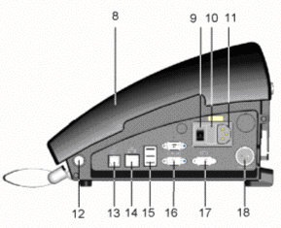
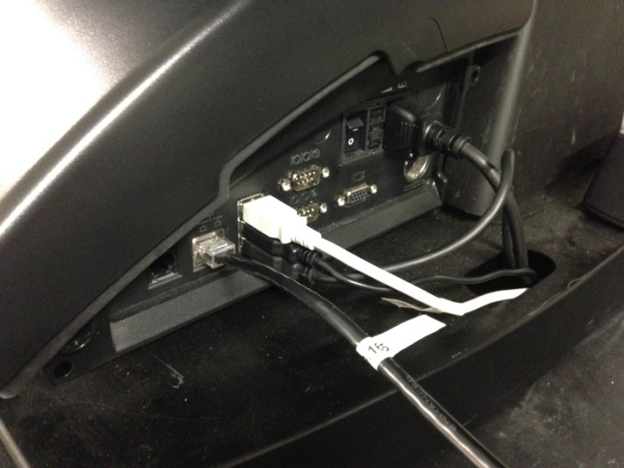
Draeger Alcotest 9510
Instrument Layout
8) Dust Cover or Top Cover
9) Main power switch
11) Power cord Receptacle
13) Modem to phone line
14) Ethernet, Intranet
15) USB ports (3x)
  Scanner USB
  Printer USB
  Keyboard USB

Slide 8
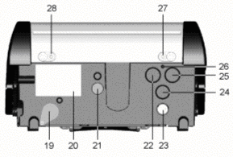
Draeger Alcotest 9510
Instrument Layout
20) Model and serial number plate
21) Wet-bath inlet port
22) Dry gas inlet port 1
25) Dry gas inlet port 2

Slide 9
Officer in Charge (OIC)
As defined by 501 CMR 2.00
Officer In Charge (OIC): a breath test operator responsible for maintaining the breath test device and breath test documentation. The Officer in Charge is the keeper of the breath test records for instruments assigned to his or her individual department or barracks.
2.10: Officer in Charge (OIC): Training and Designation
  (1) For each certified breath test device in the Commonwealth, there shall be at least one designated OIC. The OIC(s) shall be responsible for ensuring the breath test device is in proper working order and shall act as the keeper(s) of the records for such device.
  (2) The name(s) of the designated OIC(s) shall be submitted in writing by the chief of police or designee of the department or agency to the Office of Alcohol Testing. Any changes in this designation shall also be submitted in writing to the Office of Alcohol Testing.
  (3) OIC(s) must be certified BTO(s).
  (4) The Director shall establish a uniform statewide training program for the OIC. The program shall be implemented by the Office of Alcohol Testing.

Slide 10
Becoming an OIC
Must currently possess a valid Breath Test Operator certification
Fill out OIC Designation Form
  Send to OAT
Each Agency/Department needs at least 1 OIC but may have up to 3
An officer may be in charge of multiple BTs

Slide 11
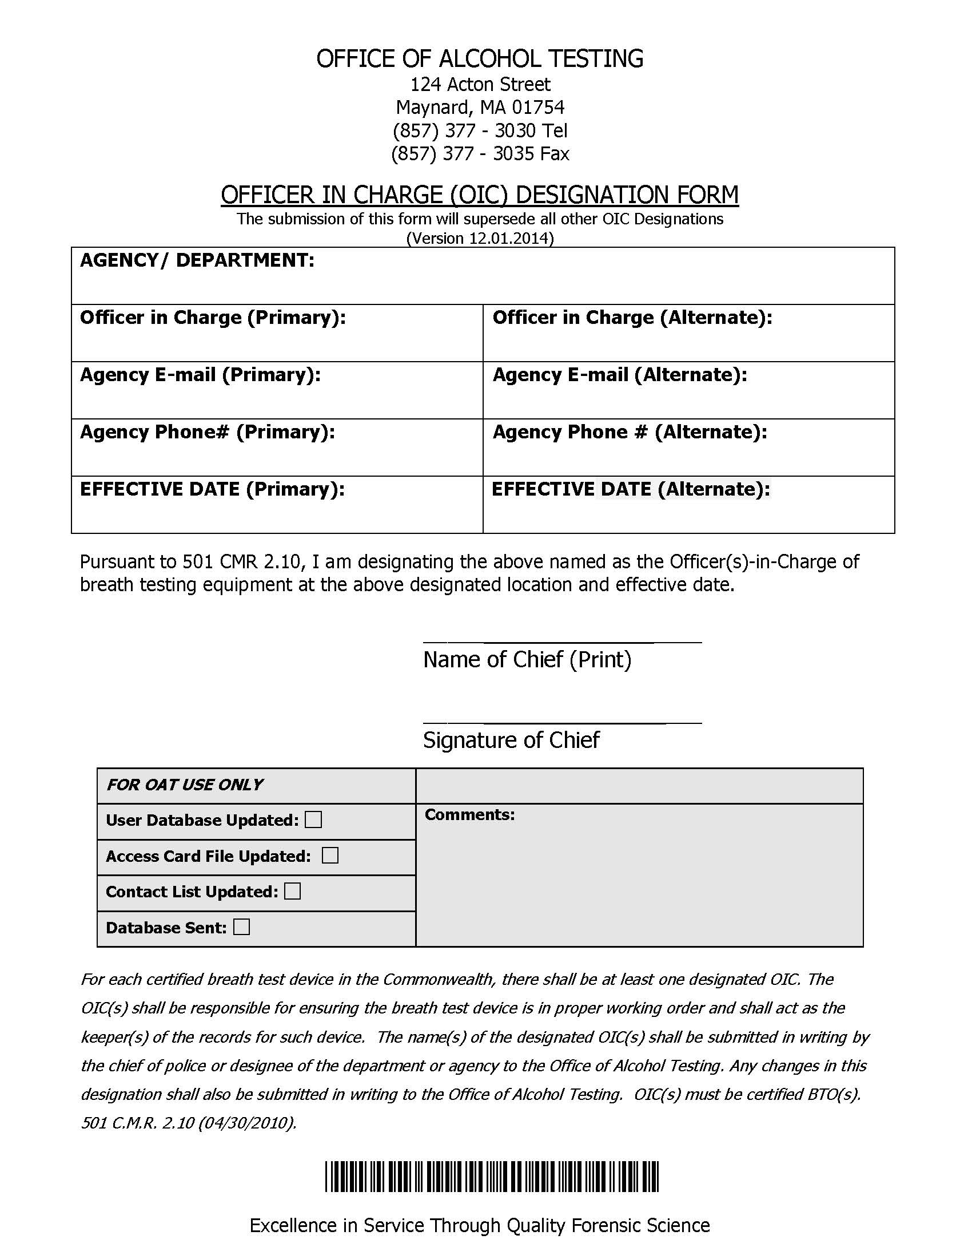
Officer in Charge (OIC) Designation Form
Agency E-mail and Phone Number
ONLY

Slide 12
OIC Responsibilities
Liaison between the Agency/Department and OAT
BT Maintenance
Periodic Testing
Keeper of Records
Ordering Supplies
Monitoring BTOs status in the Agency/Department
PBTs

Slide 13
Contact with OAT
Annually, the current OIC(s) will receive an email for a BT Certification Appointment.
  Please bring all active PBTs, also.
BTO Classes and User ID List
Troubleshooting
  Red X or lose of network connection
  Any message on BT
  Printer

Slide 14
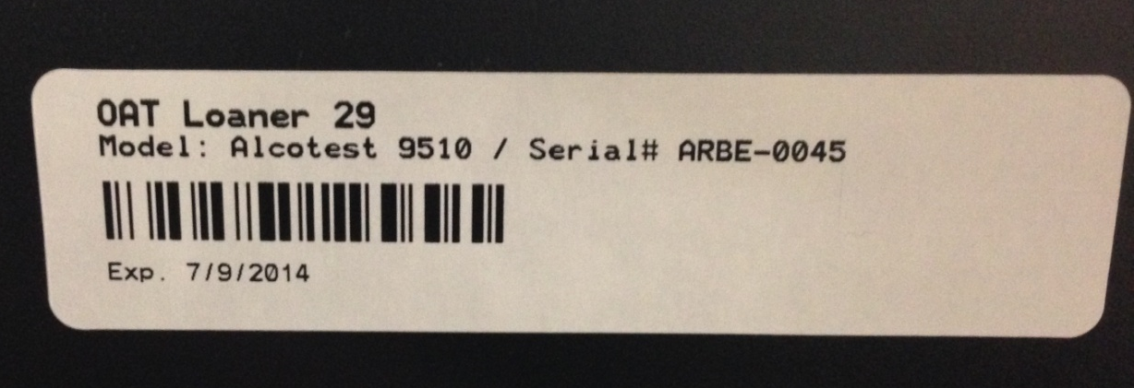
BT Certification
Annually, the BT needs to be certified by OAT.
The certification of the BT is valid for 1 year from the date the BT was certified.
OAT Certification Sticker
Located on the left side of the BT

Slide 15
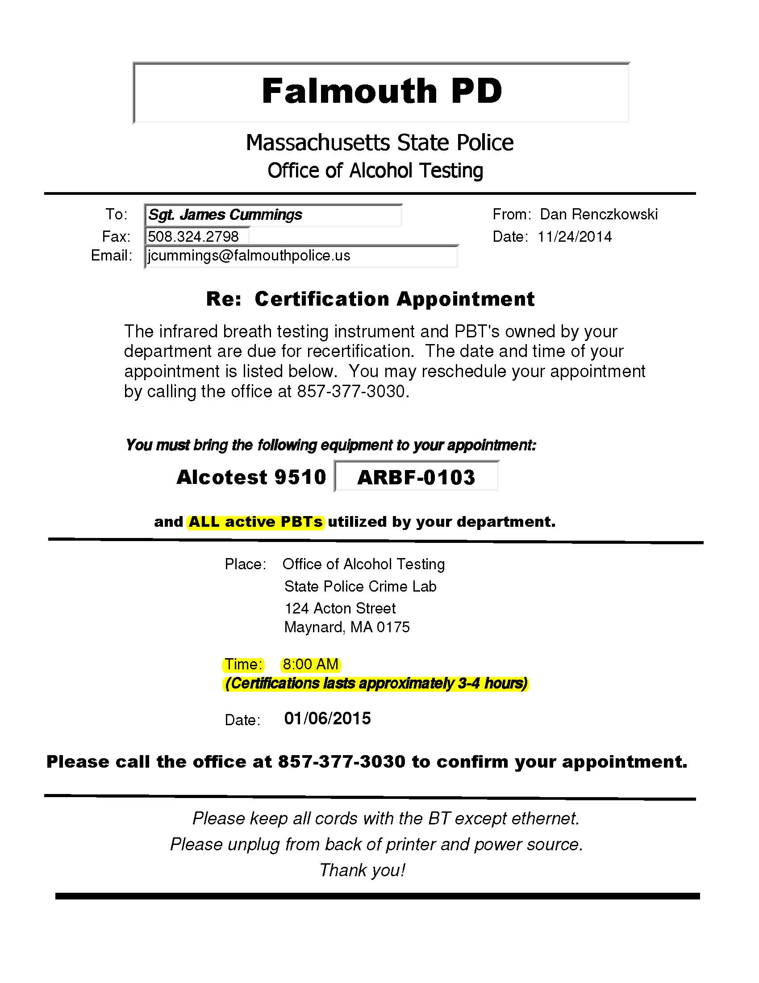
Please bring
BT and PBTs
Time and
Length of
Appointment

Slide 16
BT Certification Appointment
Appointments begin at 8:00am.
Late arrivals are not guaranteed to have their BT returned same day.
  BTs may be dropped off in advance if the 8:00am appointment time can not be met.
  Please notify OAT if you would like to take advantage of this option.
The OIC is the preferred person to transport the BT to OAT for certification.
  However, ANY officer can transport the BT to and from OAT.
The procedure could take up to 3 to 4 hours and more if necessary

Slide 17
BT Certification Appointment
In preparation for certification appointment:
  Turn off BT
    Unplug from wall or use the power switch.
    Power switch is located on the right side of the BT under the side panel.
      PLEASE be careful taking side panel off, it can break.
  Disconnect the printer USB from the printer.
  DO NOT unplug Ethernet from wall.
    Please unplug from the BT (also under the right side panel).
  Bring any PBT(s) so both BT and PBT(s) will be on the same certification schedule.
Reprint any needed tests BEFORE appointment.
BT and PBT(s) MUST be kept at room temperature at all times.

Slide 18
Periodic Test
As defined by 501 CMR 2.00
2.12: Periodic Tests
  (1) The periodic test sequence shall consist of five calibration standard analysis tests. The results of the alcohol concentration of each of these tests must be inside the range specified in 501 CMR 2.11.
  (2) At a minimum, the OIC(s) shall initiate the periodic test sequence whenever the calibration standard is replaced and after the breath test device is certified by OAT.
2.11: Calibration Standards
  (3) The gas calibration standard used as part of a valid Implied Consent Breath Test sequence shall be manufactured at an alcohol concentration of 0.080 +/- .005%. The test shall be considered valid and the device operating properly if the result of the analysis of the gas calibration standard shows an alcohol concentration of 0.074% - 0.086%.The results shall be truncated to three decimal places.

Slide 19
Periodic Testing Basics
Only an OIC can perform a Periodic Test.
A Periodic Test (or Per Test) is a series of 5 calibration standard analysis tests.
All 5 results must fall within the acceptable range.
  0.074% - 0.086%

Slide 20
Periodic Testing Basics
All 5 results must fall within the acceptable range.
  0.074% - 0.086%
Do Not only reference the Periodic Test Results section of Periodic Test Report.
Not correctly identifying a failing Periodic Test may nullify subsequent breath tests.

Slide 21
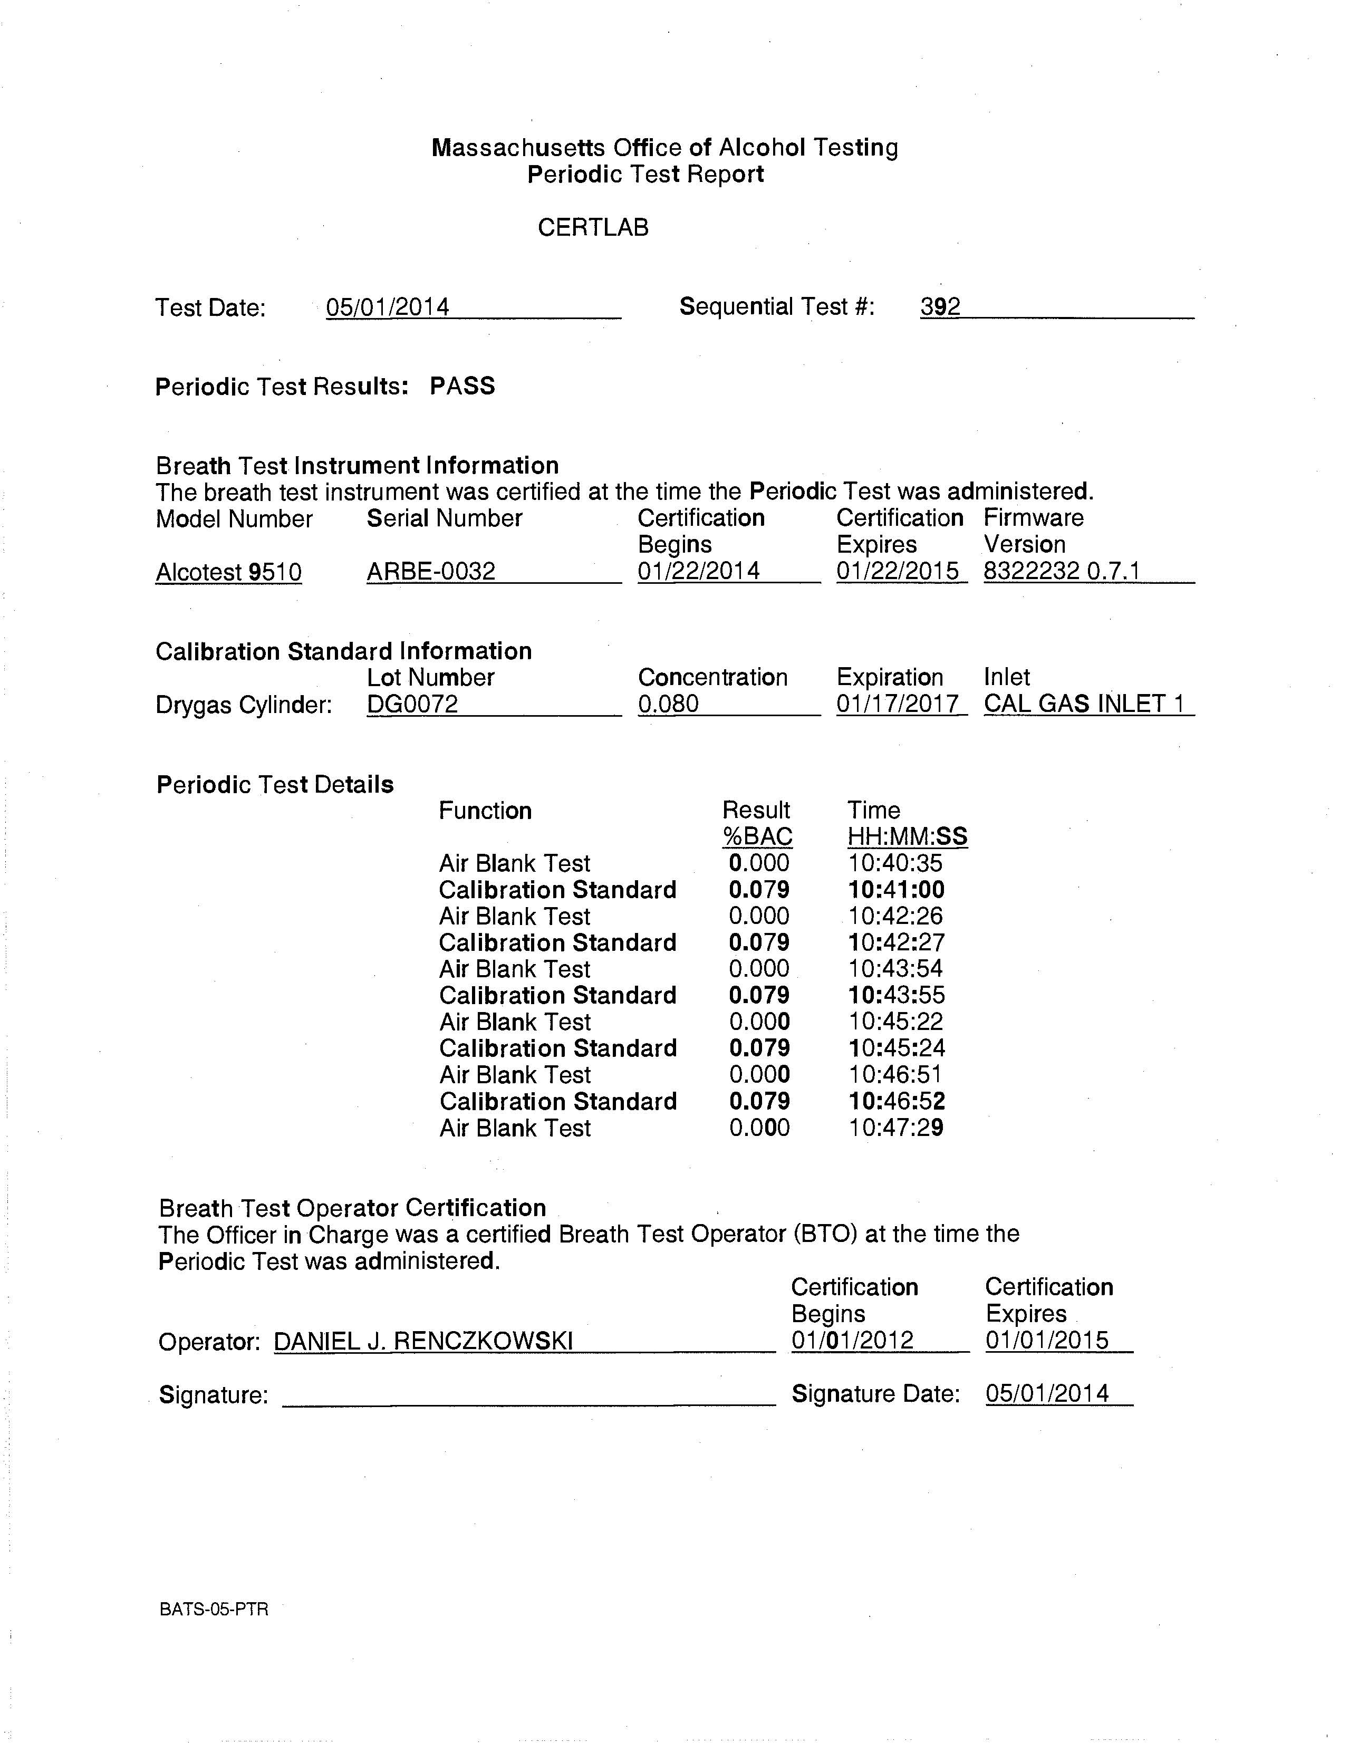
Periodic Test Report
Test Date
Sequential Test #
Lot Number
Concentration
Expiration
Inlet
Results
BTO Certification

Slide 22
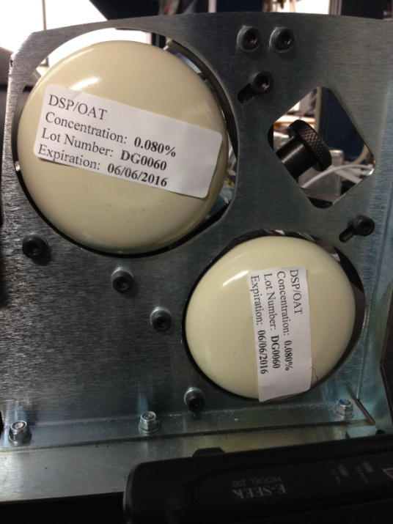
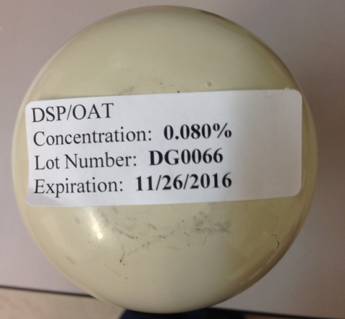
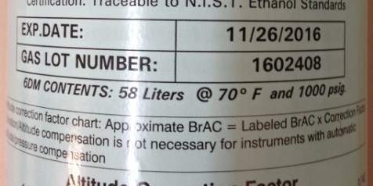
Periodic Testing Basics
Passing results: 0.074-0.086%
Cylinder 1 is the TOP cylinder
Cylinder 2 is the BOTTOM cylinder
ONLY use the OAT lot number
  Begins with DG and is at the bottom of the cylinder on the white label
  NEVER take label off cylinder (OAT use only)
Cyl 1
Cyl 2
Draeger
OAT

Slide 23
Periodic Testing Basics
Periodic Tests must be performed every 100 Days
  Internal BT printer prints a reminder at approximately 90 days from last Periodic Test.
  Approximately 100 psi is needed for a Periodic Test
    Approximately 20 psi for a subject test.
Ensure dry gas cylinders are at room temperature.
A Periodic Test is testing the BT NOT the cylinder

Slide 24
Periodic Testing Basics
**After a BT is returned after certification or from borrowing a loaner, an OIC MUST install both cylinders**
Install new cylinder?
  Yes
    After certification or repair.
    After exchanging an empty cylinder for a full cylinder.
  No
    All other required periodic tests.
Please answer the last question after the 5 tests are run.
  Printout complete?

Slide 25
Periodic Testing Basics
Which cylinder is the active cylinder?
  After a periodic test, the instrument looks at the expiration dates of the two installed cylinders
    If the expiration dates are the same:
      The cylinder with the lowest psi is set as the active cylinder.
    If the expiration dates are different:
      The cylinder that expires the soonest is set as the active cylinder.
  This same logic happens each night at midnight

Slide 26
Empty Cylinder Exchange
When a cylinder reaches a psi of less than 100, an officer can bring the cylinder to a designated lab to exchange for a new cylinder.
  Call ahead to make sure someone is there and cylinders are available.
A Per-Test needs to be conducted on the new cylinder even if one cylinder is already in the BT.
Massachusetts State Police Crime Laboratories Supplying Cylinders
OAT Forensic and Technology Center | Sudbury Evidence Control Unit (November – April) | Springfield Evidence Control Unit
124 Acton Street Maynard, MA 01754 | 59 Horse Pond Road Sudbury, MA 01776 | 190 Carando Drive Springfield, MA 01104
(857) 377 – 3030 | (508) 358 – 3155 | (413) 205 – 1837

Slide 27
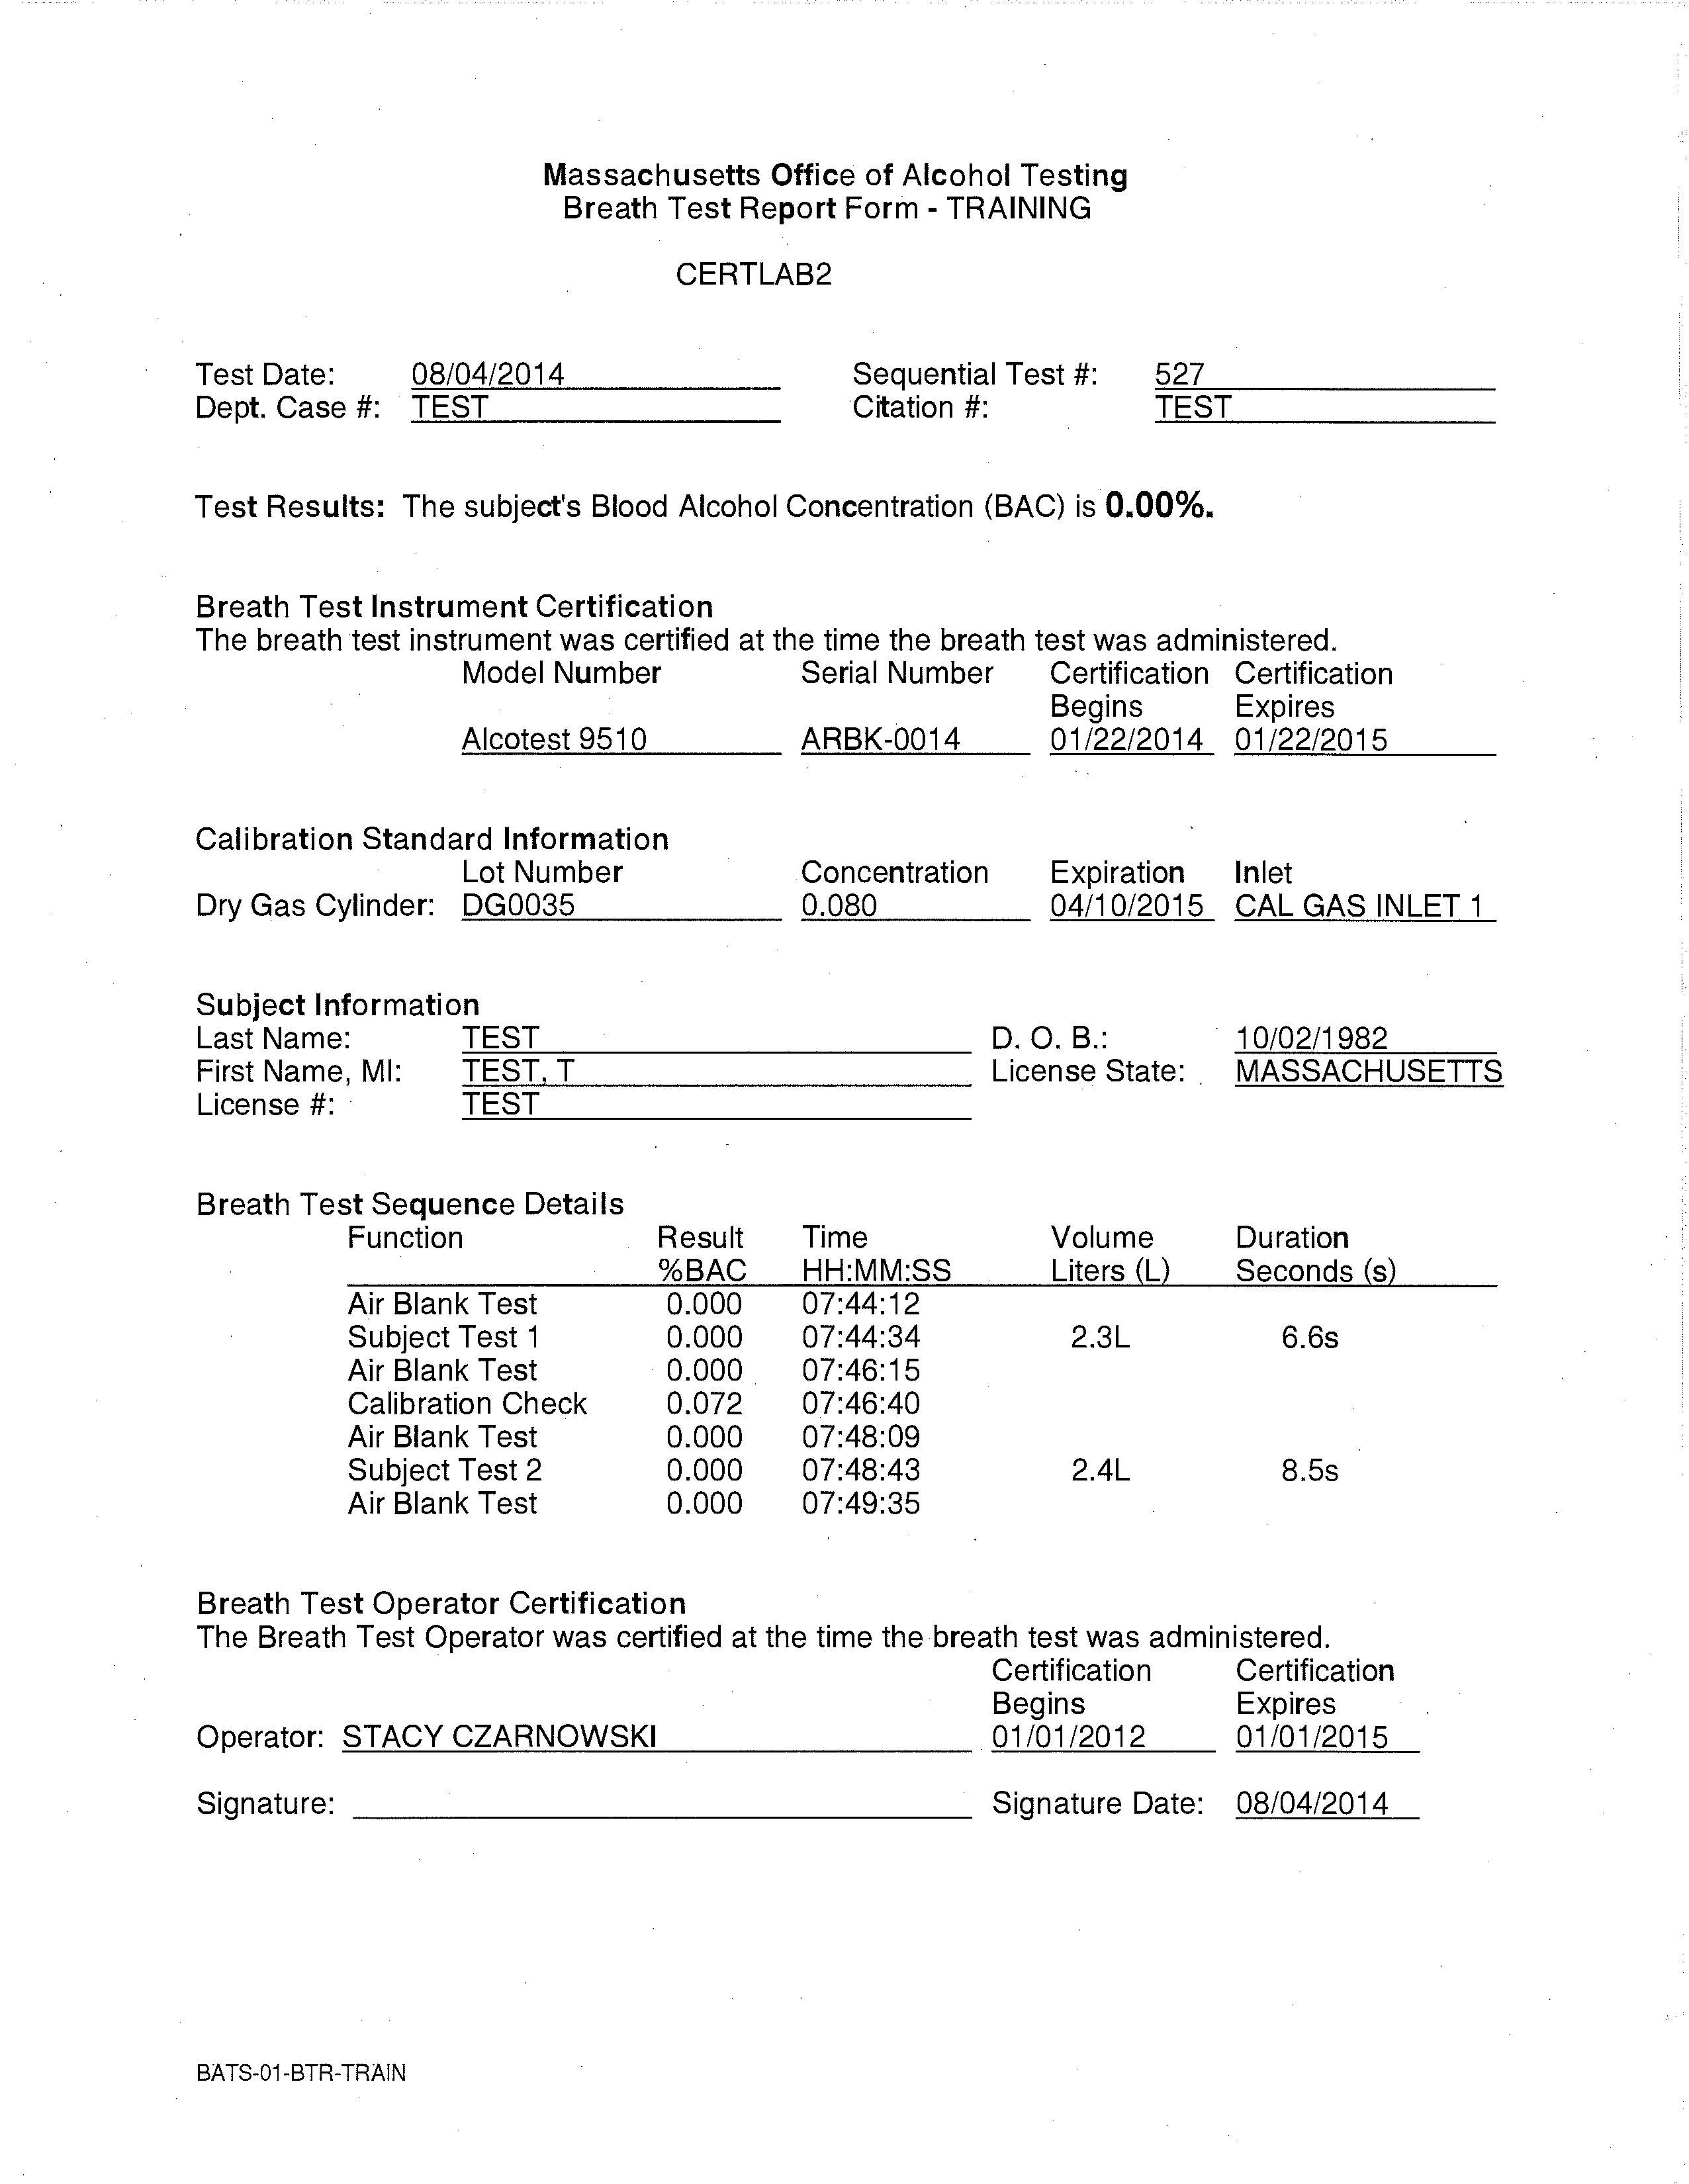
Calibration Standard Result
Every BTO MUST check the result of the calibration standard in between the subject tests.
The result must be between 0.074% - 0.086%.
If the result is not within this range, the breath test is not valid.
A valid breath test must be performed.
If another test is not performed, there is no valid breath test for the subject.

Slide 28
Keeper of Records
OIC is the Keeper of the Records for the BT at his/her Agency/Department.
Some Agencies/Departments have SOPs in place for their Keeper of the Records.
Please check with courts and ADAs as to what records are necessary to keep from the BT.
  Remember, not all records are accessible from the BT after a certification appointment.

Slide 29
Keeper of Records
You may receive a request for BT records to be used in court.
This request may be in the form of a motion.
Some documentation may be requested that is not in your possession.
Forward the motion to OAT if any request is unclear or you do not have the requested documentation.

Slide 30
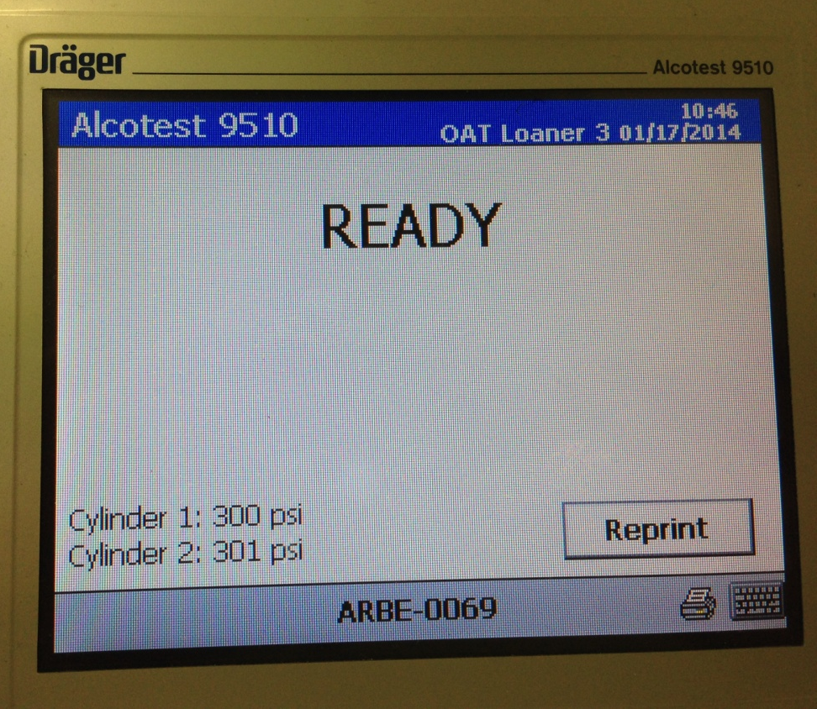
Reprint Function
Any test type or Periodic Test can be reprinted.
  90-24
  90B
  PC
  Training
  Periodic Test

Slide 31
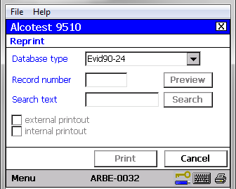
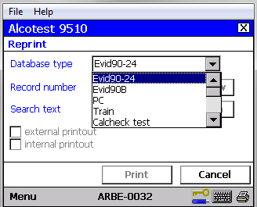
Reprint Function

Slide 32
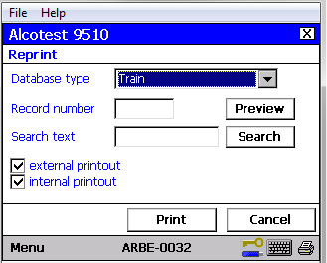
Reprint Function
Print out options:
  External: large desktop printer.
  Internal: small “ticker tape” in BT.
Be sure to select only the External Printout option.

Slide 33
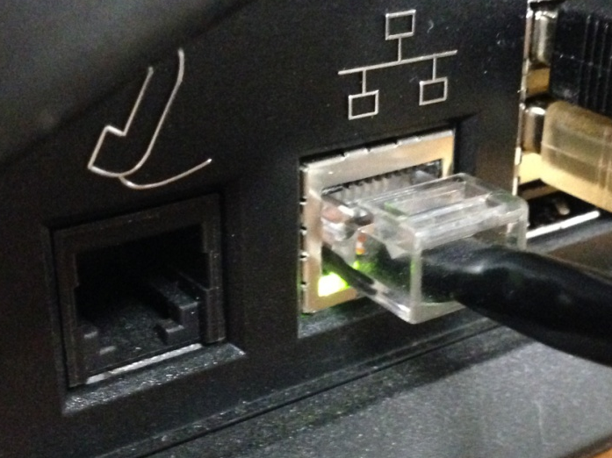
Troubleshooting
If your BT has a Red X at the bottom right corner of main screen:
  Restart
If Red X returns
  Check Ethernet Cable
    Is it plugged into BT properly?
    Is it plugged into the correct port in the wall?
    Is there a green light next to where the Ethernet cable plugs into the BT?
    Was IP changed by IT department of Agency/Department?
    Has there been any network maintenance lately?

Slide 34
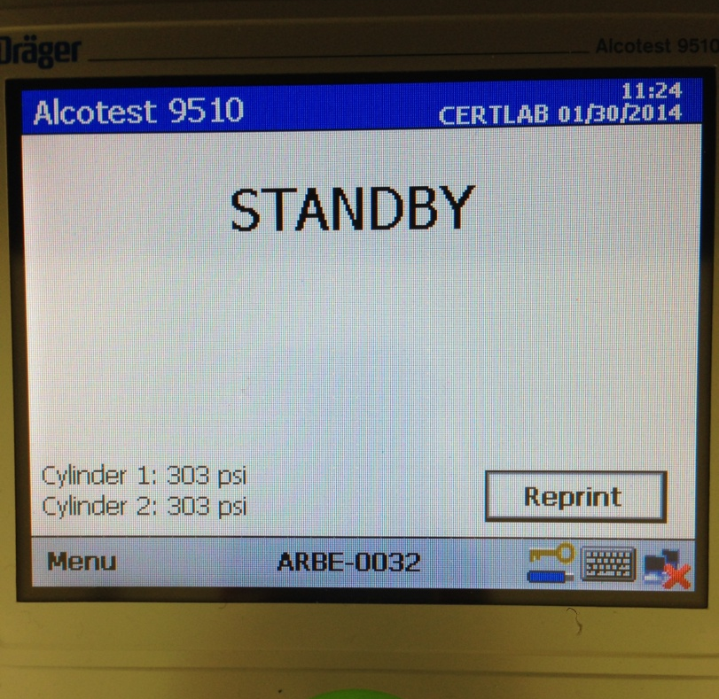
Red X No Red X

Slide 35
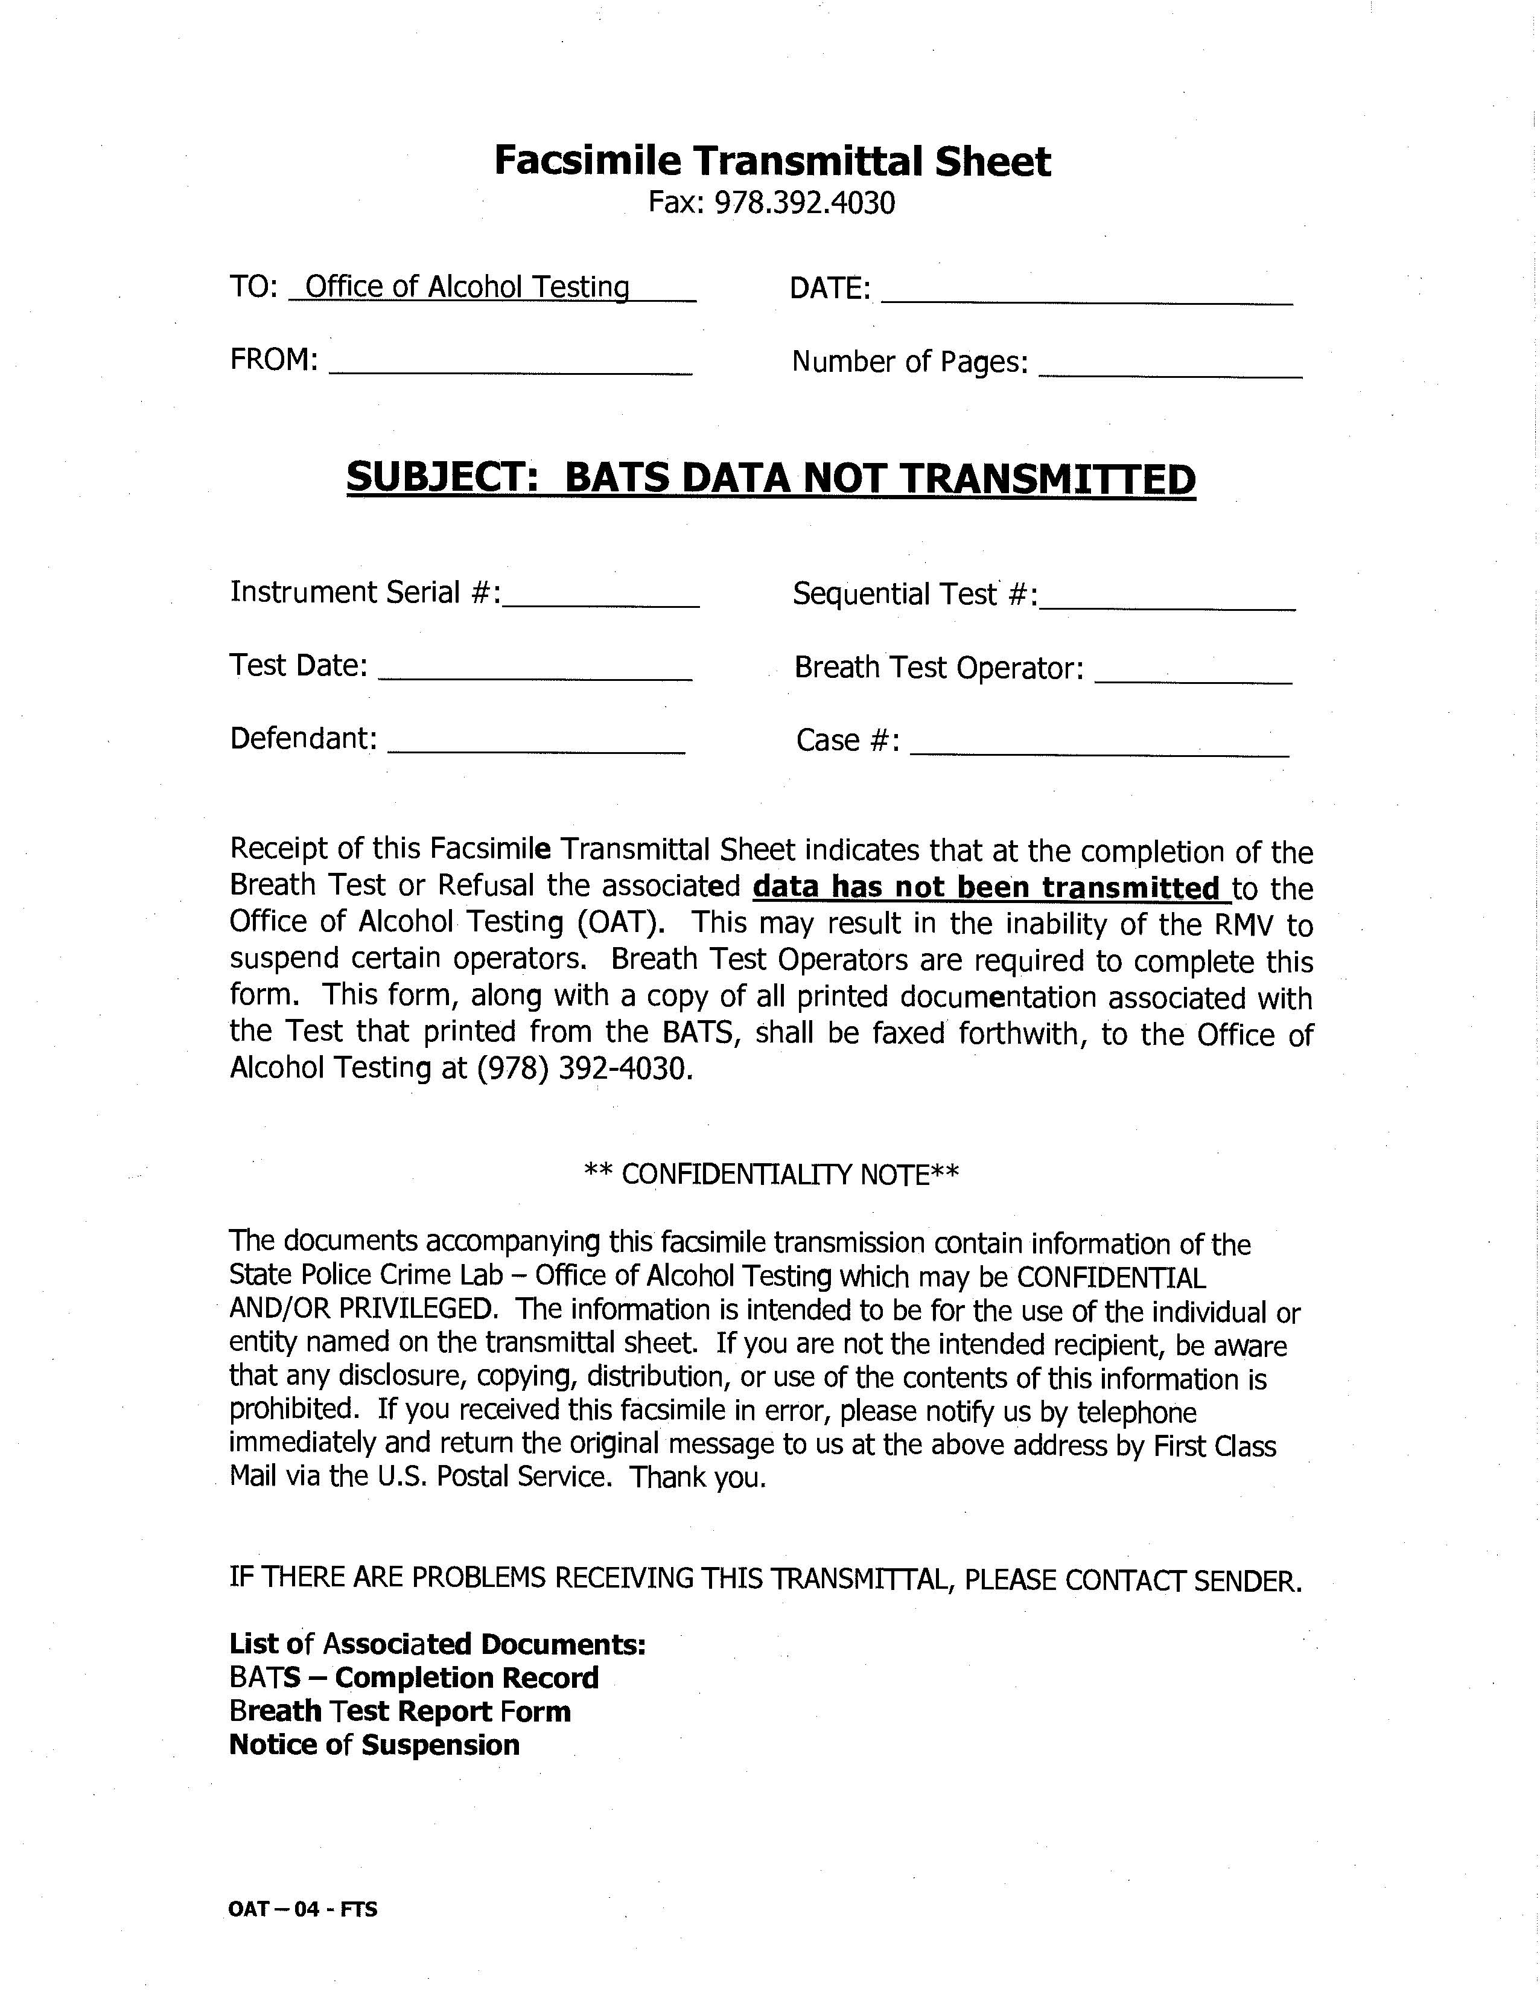
Troubleshooting
BATS Data Not Transmitted.
  Data was not transmitted to the database or the RMV.
Often the result of a loss in network connection.
  Red X
Fax to OAT with Associated Documents.
  BATS-Completion Record
  Breath Test Report Form
  Notice of Suspension
OAT will forward to RMV.
PLEASE NOTE: The OAT fax number has changed
  (857) 377 - 3035

Slide 36
Troubleshooting
If your BT delivers a message code:
  Restart the BT.
Save any internal printouts with message codes.
If restarting the BT does not resolve the issue:
  Contact OAT.
When in doubt … Restart!

Slide 37
Repairs
Most repairs are conducted by Draeger in Erving, Texas.
Bring your department’s instrument to OAT.
  All components are documented.
You may receive a loaner instrument.
  The OIC MUST install both cylinders.
You will be contacted once your department’s instrument is ready for pick up.
A Loaner instrument MUST be returned with all components.
  All cords and covers.
Your department’s instrument may not be returned if all components of a Loaner instrument are not present.

Slide 38
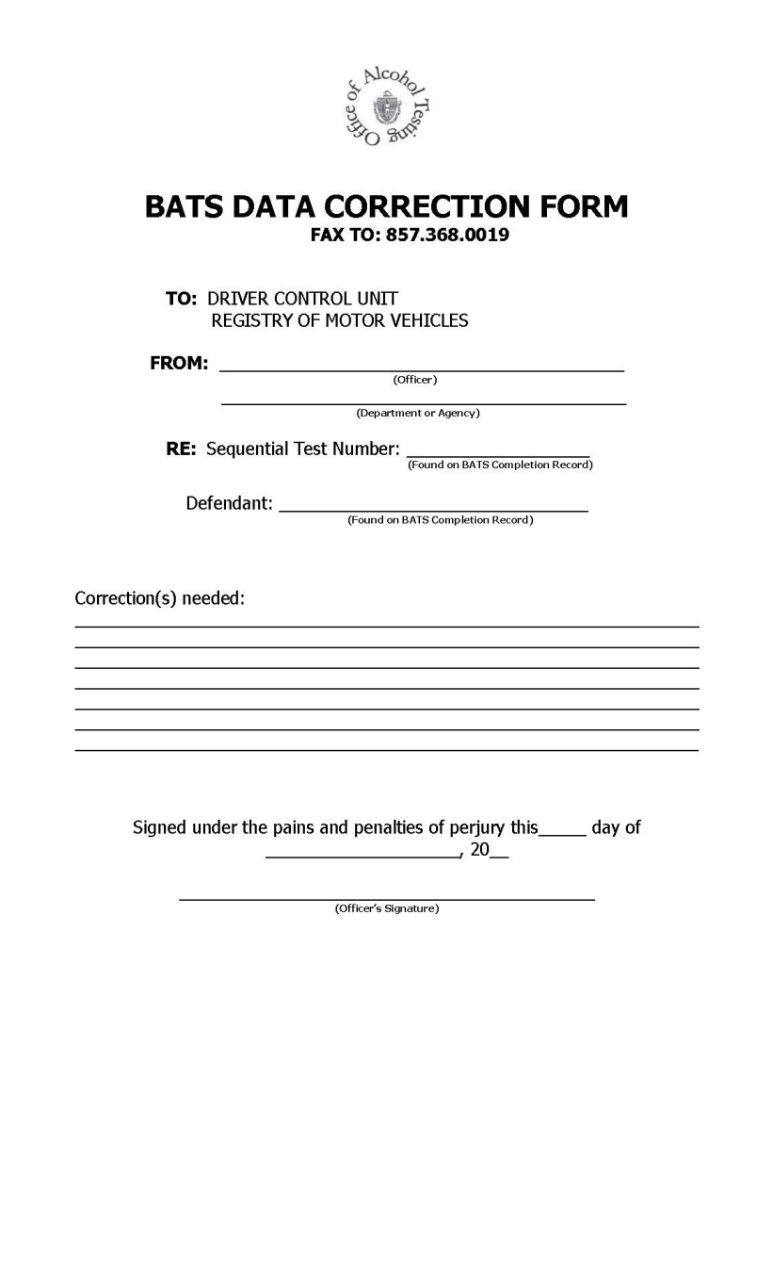
BATS Data Correction Form
Use this form to correct any information in a breath test.
Subject information
BTO Information
Observations
Test performed in error
  90-24 instead of a Training Test

Slide 39
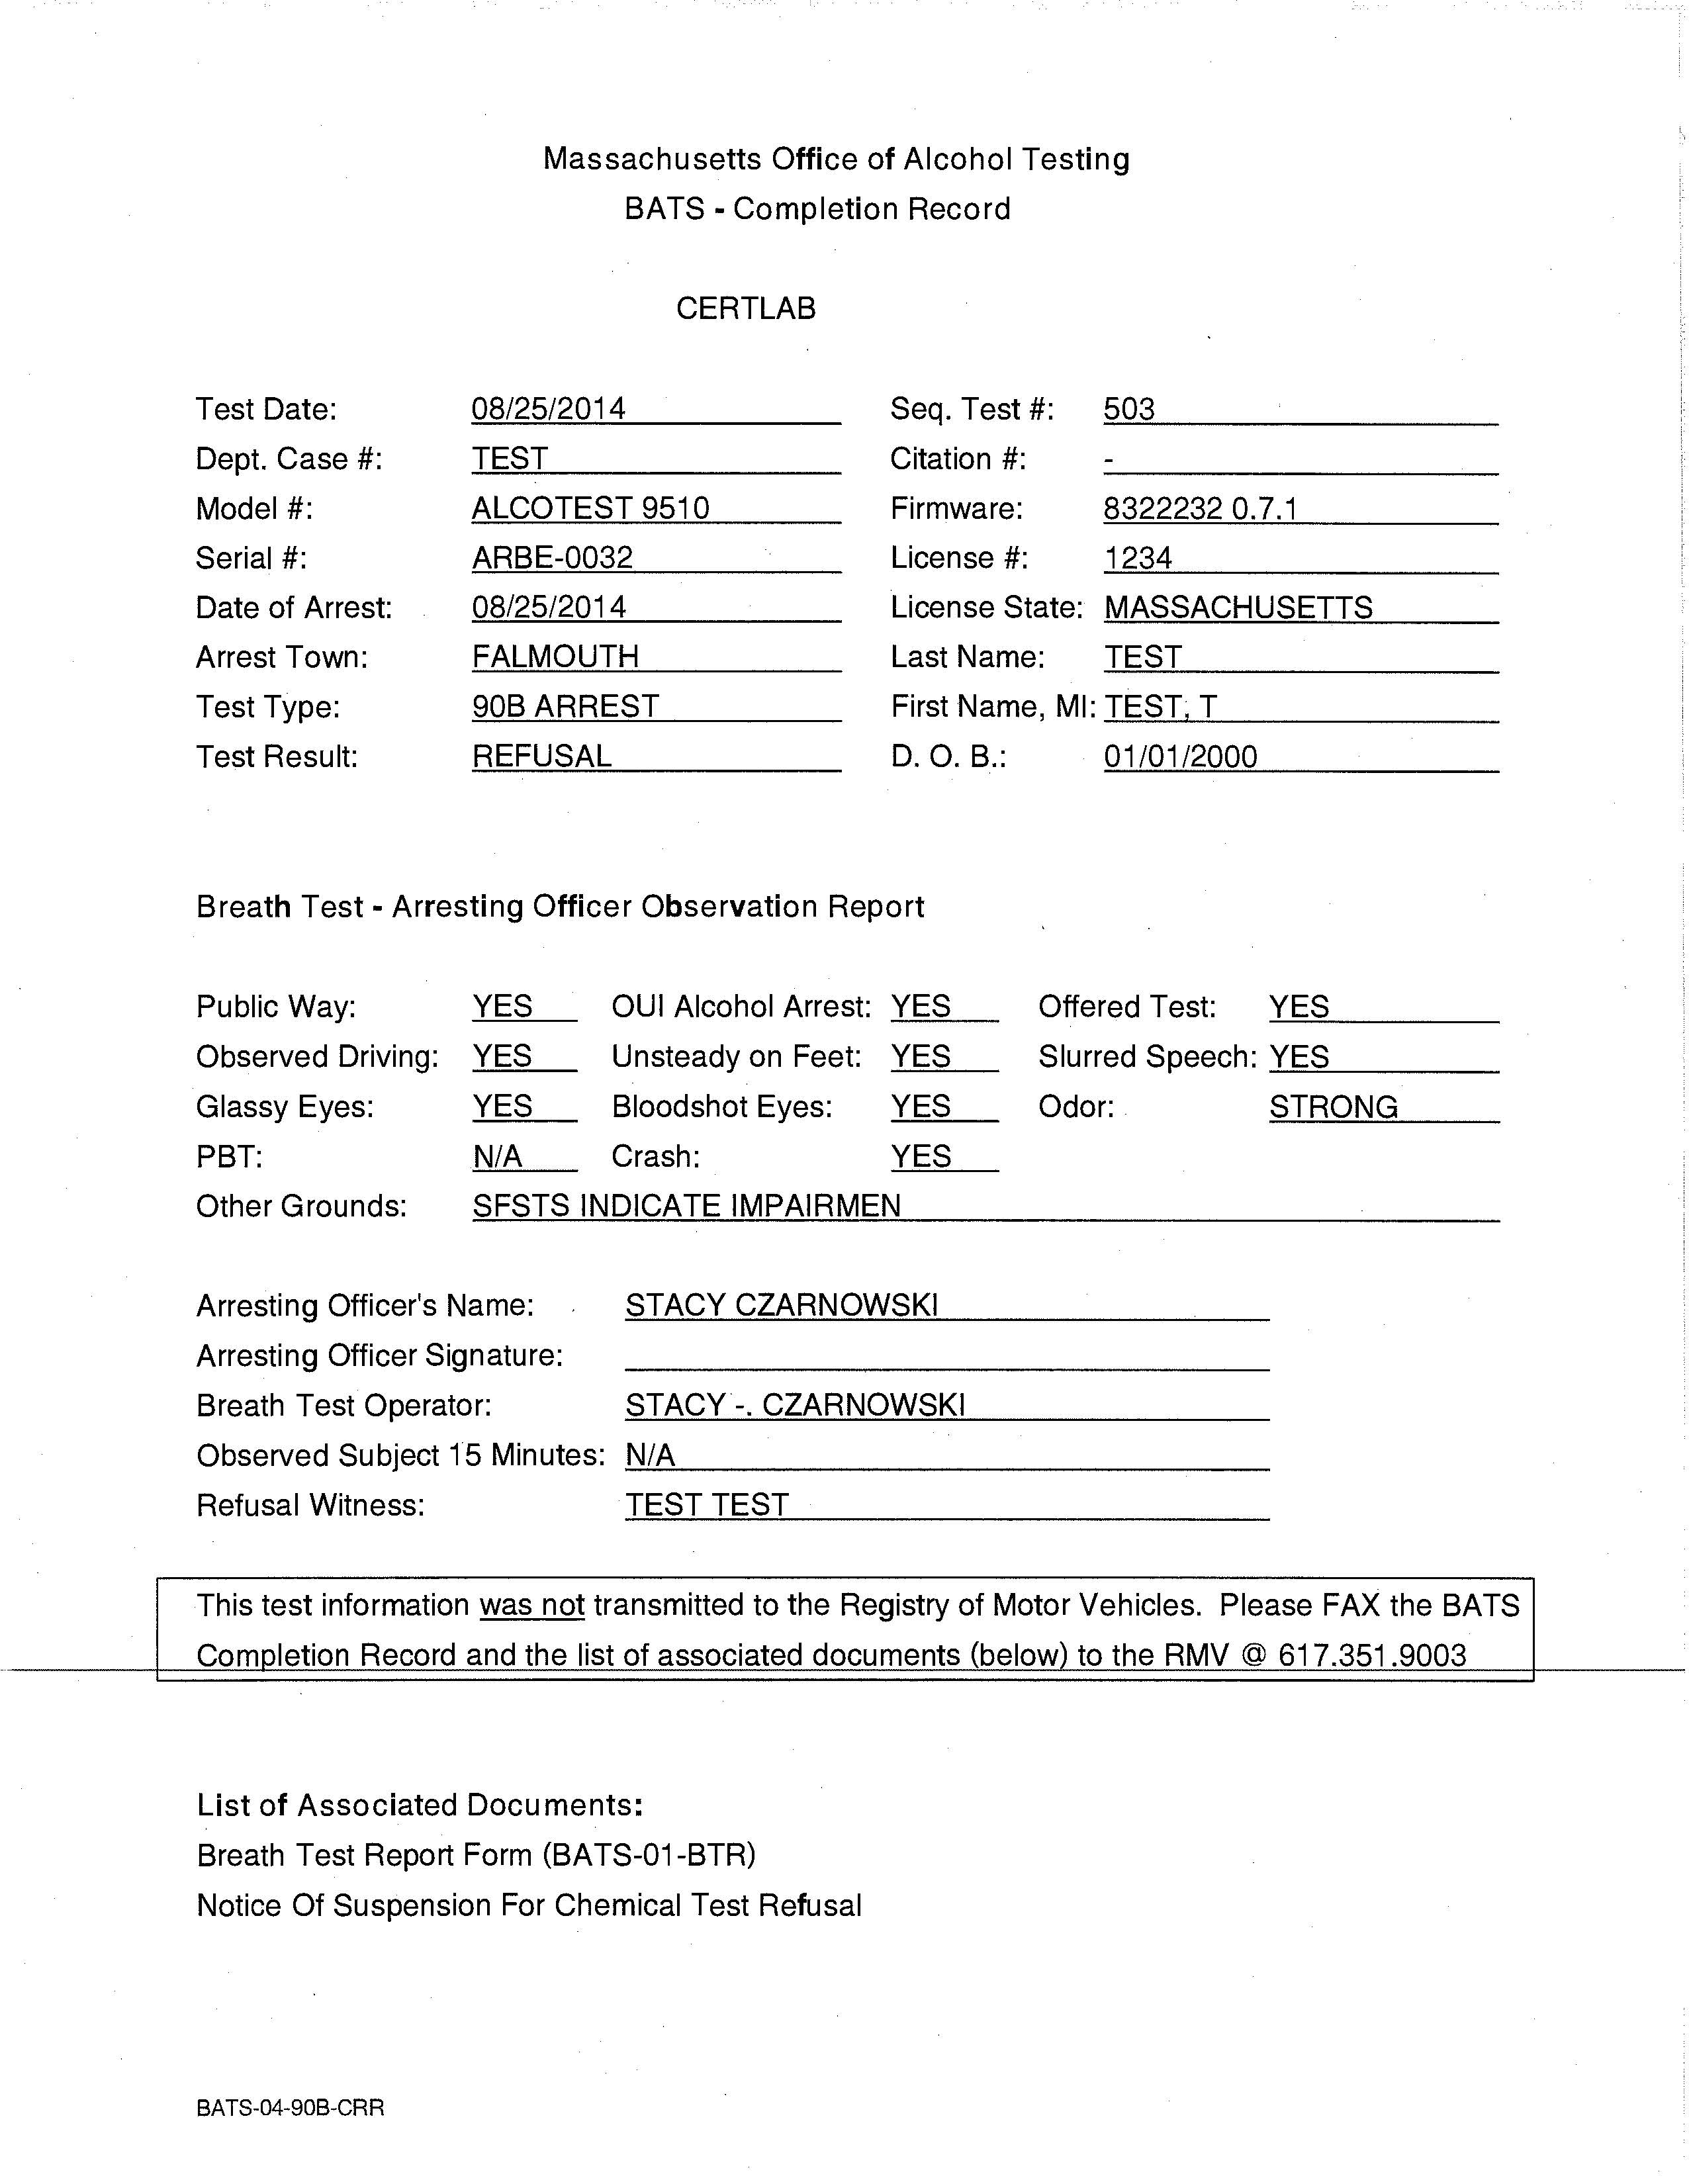
90B
Please note the RMV fax number on the 90B Completion Record has changed.
The correct number is (857) 368 – 0019.
90B tests are NEVER transmitted to the RMV.
A BATS Data Not Transmitted cover sheet will NEVER print after the test.

Slide 40
Ordering Supplies
The Agency/Department is responsible for the following supplies for the BT:
  Toner
  Paper
  Mouthpieces
OAT provides dry gas cylinders and annual certification

Slide 41
Monitoring Breath Test Operators (BTOs)
Monitor the BTO status (expired or current) of members of the Agency/Department.
This will prevent the BTO status of officers from lapsing.
Where are BTO Classes listed?
  http://www.mass.gov/eopss/law-enforce-and-cj/law-enforce/mptc/training-and-academies/specialized-professional-development/
  If no class location is convenient, a Breath Test Instructor can be hired to instruct a “private” class.
  This is at a cost to the hiring Agency/Department.

Slide 42
Monitoring Breath Test Operators (BTOs)
Breath Test Operator Certification
  Valid for 3 years from the date of class.
  Can be certified again any time within 3 years certification.
Certification still valid if BTO changes departments or works for more than one department.
  Contact OAT by written letter advising of change.
No extensions granted
  Expired means expired.
  Cannot give breath tests.
UNDER NO CIRCUMSTANCES ARE YOU TO USE SOMEONE ELSE’S OPERATOR ID TO GIVE A BREATH TEST OR PERFORM A PERIODIC TEST.

Slide 43
Monitoring Breath Test Operators (BTOs)
UNDER NO CIRCUMSTANCES ARE YOU TO USE SOMEONE ELSE’S OPERATOR ID TO GIVE A BREATH TEST OR PERFORM A PERIODIC TEST.

Slide 44
Monitoring Breath Test Operators (BTOs)
After a BTO class, paperwork can take up to one month to process.
  Plan accordingly to prevent BTOs from expiring.
OIC(s) will be emailed an updated User ID List.
  Upon receiving the User ID List, make sure those BTOs that are no longer employed by PD are not on the list.
  Contact OAT to make any necessary changes.
User ID List can be posted by the BT.
Ensure all updates, notifications, and memos from OAT are distributed and reviewed with all current BTOs.

Slide 45
PBTs
PBTs should come in for annual calibration. We recommend the same day as BT appointment.
The Agency/Department is responsible for the purchase of mouthpieces and dry gas for accuracy checks.
OAT recommends the OIC(s) should run monthly accuracy checks on PBT.
PBTs no longer use wet bath – only dry gas

Slide 46
Thank you!
Questions??

