Slide 1
introducing
OUTLOOK 2010
Tips and tricks to get the most out of Outlook

Slide 2
Enhancing your communications and organization
1
2
3
Best Practices
Calendar / Meetings
Email

Slide 3
Best Practices
1
Communicate and work effectively

Slide 4
Best practices regardless of technology
Calendar / Scheduling
Keep your calendar up to date
Check other people’s calendars when scheduling a meeting
If declining a meeting, propose alternate dates/times
Use specific “Subject” descriptions, e.g.,
  “Chat”
  “Discussion to identify testers for time tracking program”
Provide a specific location (or at least “TBD”, if currently unsure)
Provide a succinct agenda in the description
Update the invitation to reflect changes. Don’t send email
Attach documents for discussion to the meeting invite
Don’t ignore an invite – respond
Don’t wait until just before a meeting starts to accept

Slide 5
Best practices regardless of technology
Email
Add a signature file to all emails and replies
(including on your mobile device)
Include a person in the “To:” field when seeking an action from them
Include a person in “Cc:” as an FYI
Turn on grammar and spell checking
Specific “Subject” descriptions, e.g.,
  “Need input”
  “Need feedback to finalize ERS report”
Clearly state the “ask” in 1st two sentences
Add your image to your emails
“Email Golden Rule”. If you have exchanged three emails without resolution of the issue, phone the person
  Salutation
  Name
  Title
  Agency and division
  Address
  Email address
  Landline phone
  Mobile phone

Slide 6

Calendar /
Schedule
2
Basics
Create an appointment
Create a meeting
Check availability
Ensure your calendar is visible
Create a shared team calendar
View your Google calendar in Outlook
Getting the most from Outlook calendaring

Slide 7
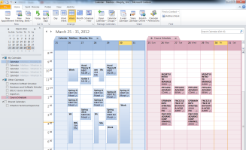
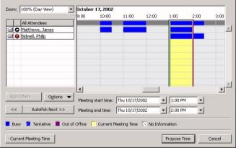
Outlook Calendar - Basics
Calendar / Scheduling
You can view time blocks in other people’s calendars
You cannot view calendars outside CPCS
You can send meeting invites outside CPCS
A Scheduling Assistant will help you find a time for attendees
Appointments can be declined, accepted or marked tentative
You can attach files to meetings
You can suggest a different time to a meeting organizer

Slide 8
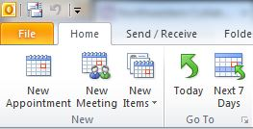
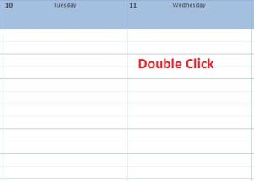
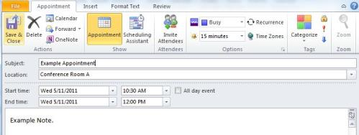
Outlook Calendar – Creating an appointment
An appointment is a reminder. Only you are invited
Two ways to create an appointment:
Click New Appointment in the Ribbon
Double click an area on your calendar
The Appointment window will open.
Type a subject for your appointment in the Subject field
Type a location for your appointment in the Location field
  Click the down arrow (right side) to see previous locations used (saves typing)
Set a start and end date and time for your appointment
Type a note for your appointment in the large text box
Click in the Reminder field in the ribbon to set a reminder for your appointment

Slide 9
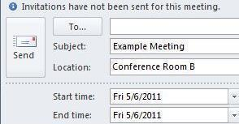
Outlook Calendar – Creating a meeting
A meeting is an event where other people are invited. To create a meeting:
Click New Meeting in the Ribbon
Click in the To… field, like you are sending an email, and type the invitee’s name/email
Type a start and end date and time, meaningful subject, location, and a brief agenda/description of the meeting

Slide 10
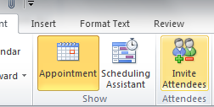
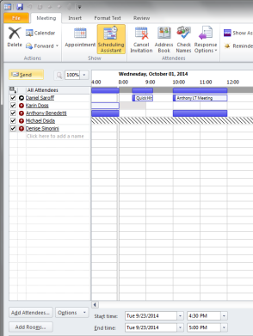
Outlook Calendar – Checking availability
When creating a meeting, check invitee availability (whether there is a conflict)
Click ❶Scheduling Assistant in the Ribbon
  You will see invitee appointment blocks to help you find the best time
  ❷Grey block means that time is outside their work hours
  ❸Grey hashing means the person is blocking their calendar from view (or are not part of CPCS)
    Ask them nicely to allow viewing of their booked time blocks
❶
❷
❸
Redacted
You will receive an email when someone accepts your meeting

Slide 11
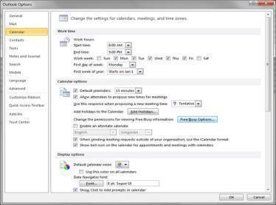
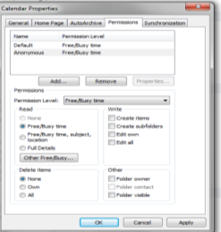
Outlook Calendar – Ensuring your calendar is visible
You want people to see your busy time slots so they don’t schedule appointments over existing meetings. To ensure they can see your taken time blocks:
Click File menu in Outlook
Click Options
Click Calendar
Go to ❶Calendar options and
Click ❷Free/Busy Options… button
Select ❸Default and select ❹Free/Busy time radio button under the Read sections. Do the same with Anonymous
Click OK until you are out of all menus
❶
❷
❸
❹

Slide 12
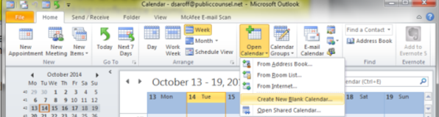
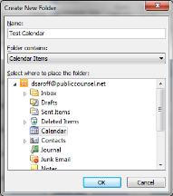
Outlook Calendar– Create a shared team calendar
Why create a shared team calendar?
Because it lets everyone on a team see all team member events in one place. For example, a number of practice offices use a shared calendar to show all court dates for everyone in the office, to aid in management of the office, delegation of cases, etc. Another use is a shared calendar for booking conference rooms.
Go to your calendar and
Click Open Calendar and then click Create New Blank Calendar
Type name of the new calendar and
click OK

Slide 13
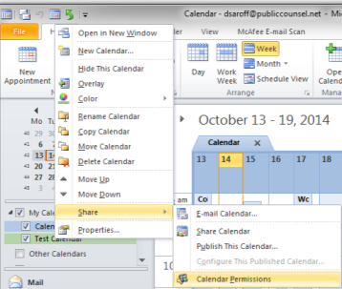
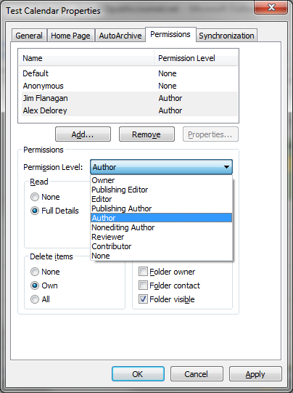
Outlook Calendar– Create a shared team calendar
Go to your calendar and
Right click your new calendar, click Share, click Calendar Permissions
Click on the Add button and select the user(s) you
wish to add to the calendar, then give them
Author permissions
Click OK until complete

Slide 14
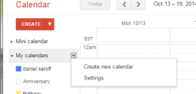
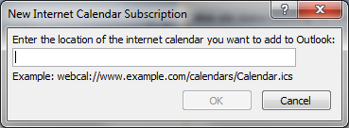
Outlook Calendar– View your Google calendar in Outlook
Why view a Google calendar in Outlook?
Some staff use Google for personal appointments and Outlook for work appointments. This can make scheduling challenging, because it requires flipping between two calendars. By viewing a Google cal in Outlook, you see your calendars in one location.
Log into Google Calendar and under My Calendars click on Settings
Click the calendar you wish to view in Outlook
Click the ICAL button in the Private Address section and copy the address
Open Outlook Calendar. Click the Home Tab on the Ribbon, and click on Open Calendar and click From internet…
In New Internet Calendar Subscription
popup box, paste your Google calendar
URL, and click OK
NOTE: You can only read the Google calendar in Outlook. Your Outlook appointments are not added to Google.

Slide 15
Email
3
Basics
Create a signature
Read email
Send email
Out of office messages
Recall email
Add your image
Add your contact information
Assigning tasks and deadlines
Getting the most from Outlook email

Slide 16
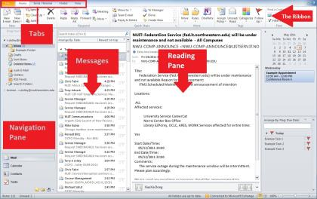
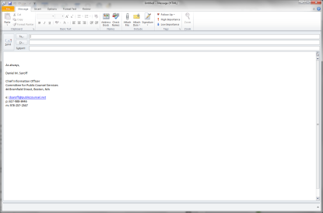
Outlook Email - Basics
Email
You can send an email outside CPCS
Outlook email will autofill frequently used email addresses
You can use different fonts in you body text, but not all email systems will see this
Email can be categorized with color codes
Email can be tagged with importance
Email can be flagged for follow-up
Emails can be saved outside Outlook
Even though email and attachments are scanned for viruses, if you don’t know the sender or the sender’s message seems too generic or strange, DON’T open attachments or click links!! Send IT a help desk ticket and ask them to examine the email

Slide 17
Outlook Email – Create a signature
Why create an email signature?
So people who receive your email (or replies) know who you are, your role in CPCS and how to contact you easily. We are a big organization (800+ people) and a surprising number of people don’t know who you are or how to reach you!
You email should contain:
Salutation
Name
Title
Agency and division
Address
Email address
Landline phone
Mobile phone (optional)
As always,
Daniel M. Saroff
Chief Information Officer
Committee for Public Counsel Services, Information Technology
44 Bromfield Street, Boston, MA
e: dsaroff@publiccounsel.net
p: 617-988-8446
m:

Slide 18
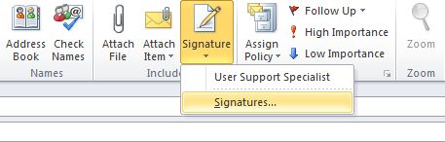
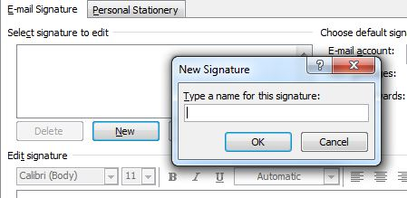
Outlook Email – Create a signature (continued)
The steps to create a signature are:
Click the Home tab, if necessary
Click New E-mail in the New section of the Ribbon. The new e-mail window will open
Click Signature in the Ribbon
Click Signatures… in the drop down menu. The Signatures and Stationary window will open
Click New to create a new signature
Type the name of your signature in the New Signature window that appears
Click OK

Slide 19
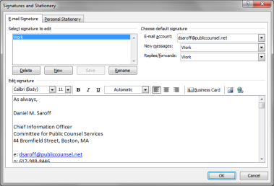
Outlook Email – Create a signature (continued)
The steps to create a signature are:
Type your desired signature in the text box
Click Save to save your signature
Add additional signatures or click OK to exit

Slide 20
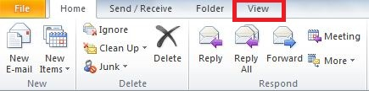
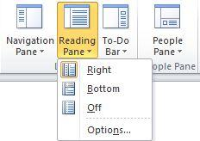
Outlook Email – Read email
You can view an email by double-clicking it or automatically in the Reading Pane
The Reading Pane can be moved (to the right or bottom of the screen) or turned off or on. The Reading Pane shows the body of the email when you click on the email
Click the View tab
Click Reading Pane in the Layout section of the Ribbon
Click Right, Bottom or Off

Slide 21
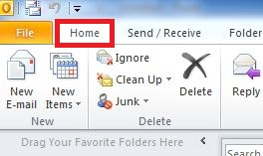
Outlook Email – Send email
Click the Home Tab if necessary
Click New E-mail in the New section of the Ribbon. The new e-mail window will open
Type the address of the recipient in the To... Field
  It will auto populate an already used address
Type an address in the Cc… field if you wish to send a copy of the message to a third party
Type a subject matter in the Subject field
Type your message in the large text box
Click Send

Slide 22
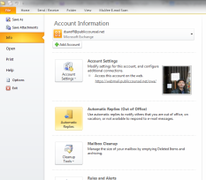
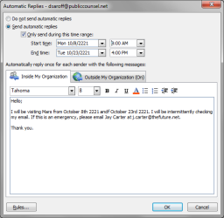
Outlook Email – Out of office messages
Click File, then Info in the menu, then Automatic Replies
Select the Send automatic replies radio button
Select the Only send during this time range:
check box, then input a start and end date and
time
  IF you don’t select a time/date range, your
  out of office message will continue until you
  manually turn it off!
You can have a different message for people
inside CPCS and externally
Click OK to save changes

Slide 23
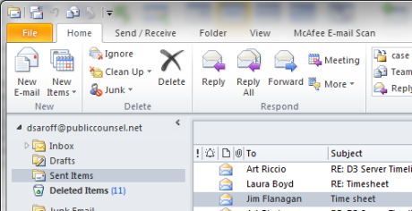
Outlook Email – Recall a message
Why recall a message?
Sometimes we prematurely send a message: mistakenly hitting send before it was complete or you decide the email is unnecessary or maybe the tone, in hindsight, needs to be changed. A recall will delete the message from the other person’s inbox.
NOTE: If the person reads the message before you recall it, the recall will fail.
To recall a message:
Find your email in the Sent Items folder
Double-click the message to open it
Click Actions in the Move section of the Ribbon
Choose Recall This Message.
Select Delete unread copies of this message or Delete unread copies and replace with a new message and click OK.
You will get a response whether the message has been recalled successfully

Slide 24
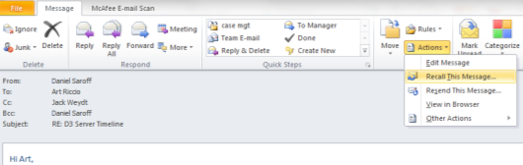
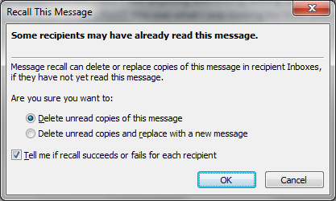
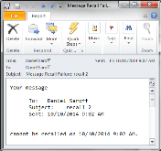
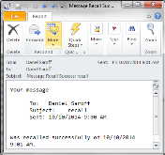
Outlook Email – Recall a message (continued)
To recall a message:
Find your email in the Sent Items folder
Double-click the message to open it
Click Actions in the Move section of the Ribbon
Choose Recall This Message.
Select Delete unread copies of this message or Delete unread copies and replace with a new message and click OK.
You will get a response whether the message has been recalled successfully

Slide 25
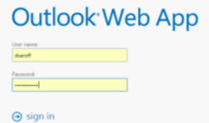
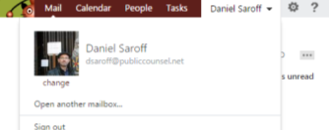

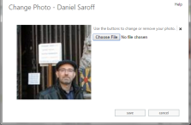

Outlook Email – Add your image
Go to webmail at https://webmail.publiccounsel.net/owa/
Login with you normal username and password
Click (upper right corner) the down arrow next to your name, and click change under your image or the grey silhouette
Click Change File button and find a local image and select the image to use

Slide 26
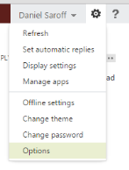
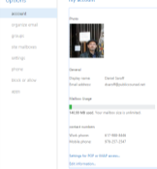
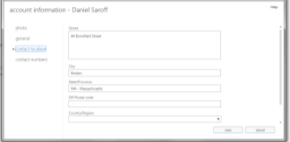
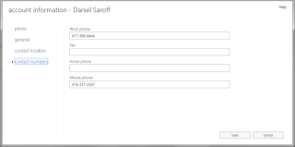
Outlook Email – Add your contact information
Outlook contacts are a simple, easy way to find people. When you are adding your image to Outlook, also add your contact information
Go to webmail at https://webmail.publiccounsel.net/owa/
Login and click (upper right corner) the gear icon next to your name, and click ❶Options and ❷Edit Information
Add your contact location and numbers
❶
❷

Slide 27
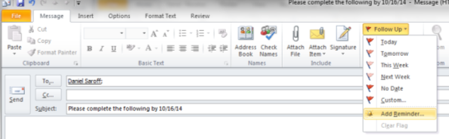
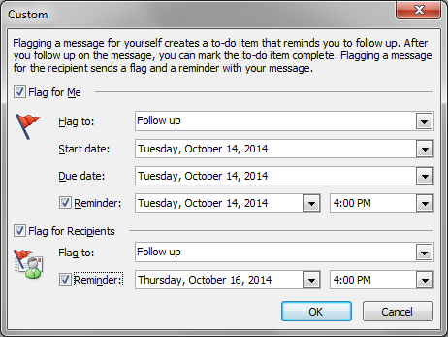
Outlook Email – Assigning tasks and deadlines
You can assign a reminder to a team member through email. This creates a means to provide deadlines for requests.
Click Follow Up in the Ribbon Bar of an email
Click Add Reminder
In popup, click Flag for Recipients checkbox
Click Reminder: checkbox and pick a date and time for the reminder, then click OK

Slide 28




Coda
Some screen shots and text were taken from Outlook training produced by Northwestern University. This training may be found at: http://www.it.northwestern.edu/collaborate/how-to/outlook2010-basic-training.html

