Slide 1
Time management with
OUTLOOK 2010
Tips and tricks to manage your time with Outlook

Slide 2
Enhancing your communications and organization
Rules
Flag for reply/review
Assignment reminders: Email/Tasks
Searching email
Auto cc: yourself
Scheduling and booking rooms
Shortcuts

Slide 3

Rules
Communicate and work effectively

Slide 4
Rules – What are they?
Rules let you automate routing of email to folders, delete email, flag emails, etc.
Rules automate steps that you take manually (like automatically copying an email from a colleague to a folder, rather than manually dragging and dropping it)
Rules help with organization and efficiency
We will look at two scenarios for Rules:
  Automatically copy a received email to a folder
  Automatically copy a sent email to a folder

Slide 5

Rules – Scenario 1: Copy a received email
This scenario will keep an email in the original folder (inbox, if received, sent, if sent), WHILE copying it to another folder
Let’s say you are working with an outside consultant, janedoe@gmail.com, and you want to copy all her emails received to a folder called, “Project Infinity”
  You must have your email window for Outlook open and create a Project Infinity folder
  Click on one of Jane Doe’s emails
  In the toolbar, click on Rules
  Click Create rule
  **If you simply want to move, not copy, Jane Doe’s emails, you’d select the From checkbox and Move checkbox and select the destination folder**
  To copy, select Advanced Options

Slide 6
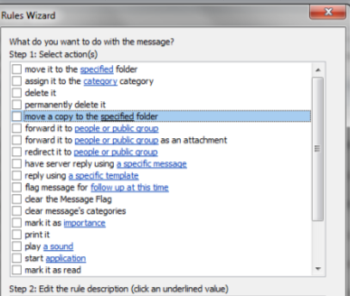
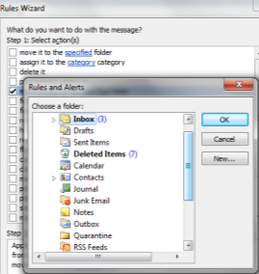
Rules – Scenario 1: Copy a received email
  You will see Step 1: Select conditions with a number of checkboxes
  Check from janedoe@gmail.com then click the Next button
  Fifth checkbox down (image), you will see move a copy to the specified folder. Select this option. In the window at the bottom, click on specified and select the folder where it will be copied
  Click Finish button. Select Run this rule now… and click Finish

Slide 7
Rules – Scenario 2: Copy a sent email
Suppose you want to have one place to look at all your response to the Chief Counsel’s emails by copying them to the Big Cheese folder
You would do the following:
  You must have your email window for Outlook open
  Create the Big Cheese folder
  In your Sent folder, click an email to bigcheese@publiccounsel.net
  In the toolbar, click on Rules
  Click Create rule
  Select Advanced Options
  You will see Step 1: Select conditions with a number of checkboxes you can choose from. Check sent to bigcheese@publiccounsel.net
  Click Next
  Click second checkbox move a copy to the…
  In the window below, select the specified link, and choose Big Cheese folder
  Click Finish button. Select Run this rule now… and click Finish

Slide 8
Rules
  Note: You can also create a rule by going to File and selecting the Manage Rules & Alerts button
  For more information on rules, see https://support.office.com/en-us/article/Manage-email-messages-by-using-rules-50307363-0e79-4f6a-95c0-04b922a2ff13

Slide 9

Flag for reply/review
Communicate and work effectively

Slide 10
Flags for reply/review – What are they?
Sometimes you don’t have time to immediately reply or review an email.
This can mean the email “disappears” from your memory as is gets pushed off screen by newly arriving email. If this happens you may find yourself not responding to emails (and being considered unresponsive) or missing critical information you need
You can flag an email message you receive to remind yourself to follow-up or take action at a later time. Your flagged message will appear in the To-Do Bar, in Tasks, and in the Daily Task List in Calendar
Flags help with organization, time management and responsiveness
We will look at two scenarios for Flags:
  Flag an email to review sometime soon
  Flag an email with an alarm

Slide 11
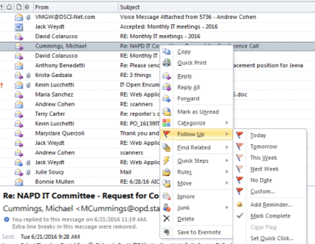
Flags – Scenario 1: Flag an email for review
You receive an email from the NAPD. You want to brief it at your next team meeting, but you don’t have time to review now
  Right click your email and
  hover your cursor over
  Follow up
  Select the option you like
  or pick Custom to create
  a custom reminder
  In this case, Next Week
  was selected
  Now you will see your
  email listed in your Outlook Tasks. You can also sort to show flagged emails by clicking the flag in the header of your email list

Slide 12
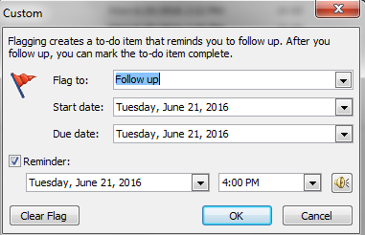
Flags – Scenario 2: Flag an email with alarm
Suppose, for the NAPD email, you want an alarm reminder that a review is due, rather than looking in your tasks
  Right click the email and select add reminder
  Pick when you would like to be reminded from the dialogue box and pick OK.
  Your email will be listed
  in your Outlook Tasks.
  You can also sort to
  show flagged emails by
  clicking the flag in the
  header of your email
  list, and you will be reminded with an alarm on the date/time you specified
Note: For more on Flags visit https://support.office.com/en-us/article/Track-e-mail-messages-that-require-follow-up-9d0f175f-f3e9-406d-bbf7-9c57e1f781cc

Slide 13
Assignment reminders: Email/Tasks
Communicate and work effectively

Slide 14
Reminders – What are they?
Sometimes you delegate a task to one of your team and want them to be reminded and have a deadline. You can do this using an email or putting a calendar appointment in their Outlook
With the email, you literally email not just the assignment instructions but the deadline and reminder
You can also create a task and assign it to someone with reminders and milestones
Reminders help with delegation, project management, commitment and expectations
We will look at two scenarios for Reminders:
  Assign a task to someone
  Send an email to someone with a reminder

Slide 15

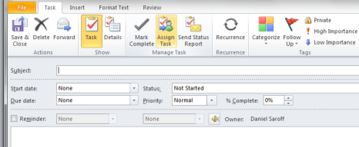
Reminders – Scenario 1: Assign a task
  You have a project you wish to delegate to one of your team with a deadline, so you assign them a task
    Open Tasks, and on the Home tab click New Task
    On the ribbon bar click
    Assign Task
    In the To box, enter the
    person to whom the task is
    assigned. Enter the Subject
    Specify the Due date and
    Status
    If you want to create a
    reminder, click Reminder
    and pick a reminder date and time
    Click Send

Slide 16
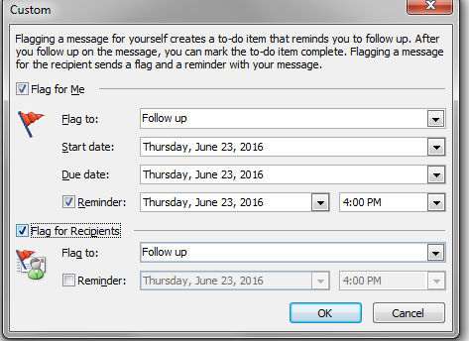
Reminders – Scenario 2: Email someone with a reminder
  You email one of your team a request and want to make sure they are will be reminded of the deadline. You set an alarm to pop-up the email on the due date
    Create a new email, add the recipient, subject and text as usual
    Select Follow Up in the
    ribbon bar and then select
    Add reminder.
    You may remind yourself in
    addition to creating a reminder
    for the recipient(s). Check the
    Flag the Recipients box to
    activate the reminder capability.
    Uncheck Flag for Me, if you
    don’t want to be reminded
    Check Reminder and pick a
    reminder date and time
    Click OK and Send

Slide 17
Shortcuts
Communicate and work effectively

Slide 18
Shortcuts – What are they?
Shortcuts are simple keyboard key combinations that perform actions.
Shortcuts help improve efficiency. They often speed up actions in Outlook
To see a complete listing of shortcuts, go to https://support.office.com/en-us/article/Keyboard-shortcuts-for-Microsoft-Outlook-2010-ae3f6efe-57d9-447c-ae38-b58ed69fc9bc

Slide 19
Shortcuts – Most common
Action | Press
Move between fields (To:, cc:, subject, body) - Email | Tab
Switch to next message (with message open) - Email | CTRL+PERIOD
Switch to previous message (with message open) - Email | CTRL+COMMA
Find a message or other item - Email | CTRL+E
Reply to a message - Email | CTRL+R
Create a message (when in Mail) | CTRL+N
Mark as read - Email | CTRL+Q
Mark as unread - Email | CTRL+U
Forward as attachment - Email | CTRL+ALT+F
Find and replace text, symbols, or some formatting commands works in the Reading Pane on an open item - All | CTRL+H
Search for text inside an open item - All | F4
Save (except in Tasks) | CTRL+S
Undo - All | CTRL+Z
Print - All | CTRL+P
Check names - All | CTRL+K
Check spelling - All | F7
Find a contact or other item (Search) - All | F3
Create a message (from any Outlook view) | CTRL+SHIFT+M
Go to a date - Calendar | CTRL+G
Go to next appointment - Calendar | CTRL+PERIOD

Slide 20

Auto cc: yourself
Communicate and work effectively

Slide 21
Auto cc: yourself – Why?
We send out a lot of emails, and we need to be able to review our emails or responses. Auto cc: yourself allows you to better organize your emails and responses for later reference
Auto cc: yourself is simply a variant use of “Rules” described earlier
Auto cc: yourself can improve efficiency by storing responses in more logical locations without manual intervention
We will look at two scenarios:
  Auto cc: all new emails or responses to your inbox
  Auto cc: all emails sent to a specific person to a particular email folder

Slide 22
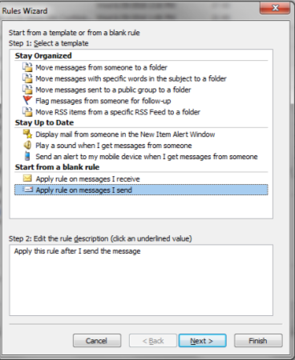
Auto cc: yourself – Scenario 1: All new emails or responses copied to your inbox
  You want all emails you initiate or respond to copied to your inbox (you can also find them in your “sent” folder)
You would do the following:
  You must have your email window for
  Outlook open
  In the toolbar, click on Rules
  Click Manage Rules and Alerts…
  Select New Rule
  Select Apply rule on messages I send
  Click Next
  Click Next without selecting anything
  (you will get the message, “This rule
  will apply to every message you send.
  Is this correct?”) and click OK

Slide 23
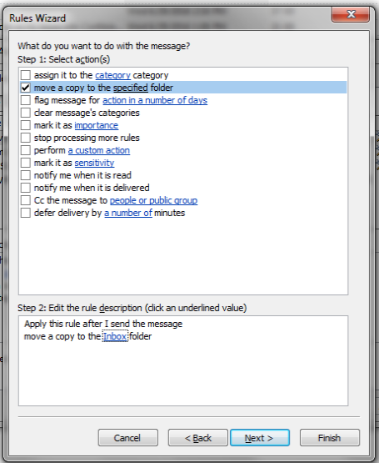
Auto cc: yourself – All new emails or responses copied to your inbox
You would do the following:
  Select checkbox move a copy to
  a specified folder
  In Step 2 box (bottom),
  click specified, and select
  Inbox (or another folder) or
  click the New button to
  create a new folder
  Click OK and Finish

Slide 24
Auto cc: yourself – Scenario 2: All emails sent to a person cc’d to a specific folder
  All emails sent to a person copied to a folder for easy reference. I use this for projects to ensure all project related emails I send are copied to my project folder for later, easy, reference
You would do the following:
  You must have your email window
  for Outlook open
  In the toolbar, click on Rules
  Click Manage Rules and Alerts…
  Select New Rule
  Select Apply rule on messages I send
  Click Next

Slide 25
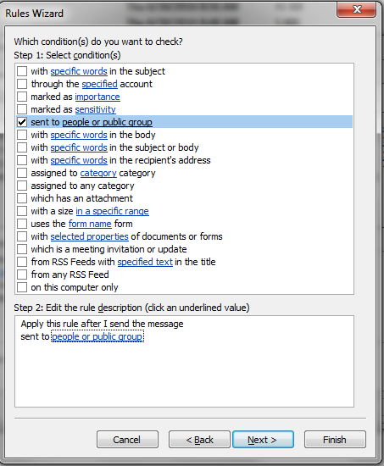
Auto cc: yourself – Scenario 2: All emails to a person cc’d to yourself
You would do the following:
  Select checkbox sent to
  people or public group
  In Step 2 box (bottom),
  click people or public group,
  and select or type in the email
  address of the person
  Click OK and Finish

Slide 26
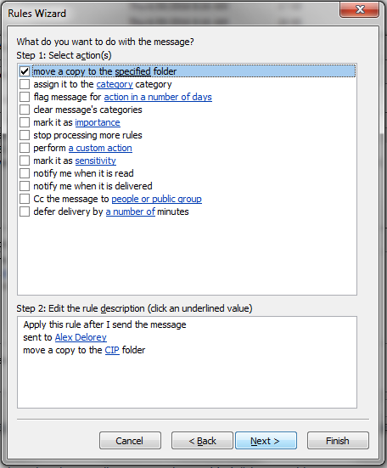
Auto cc: yourself – Scenario 2: All emails to a person cc’d to yourself
You would do the following:
  Select checkbox move a copy to
  the specified folder
  In Step 2 box (bottom),
  click specified, and select
  the folder where the emails will
  be copied or click the New button
  to create a new folder where
  the emails are copied
  Click OK and Finish

Slide 27
Searching email
Communicate and work effectively

Slide 28
Search – Why?
Search helps you find emails that may be “lost” in your mailbox
Search improves your efficiency by letting you more easily find important emails
Scenarios
  Simple search
  Search for an email sent to someone
  Search for an email received from someone
  Search expressions

Slide 29
Search – Simple search
In the Navigation Pane, click the folder that you want to search.
In the Instant Search box, type your search text.
  Items that contain the text that you typed appear with the search text highlighted.
When you are finished with the search, you can clear the search by clicking Close Search next to the Instant Search box.
  Attachments are searched, but search results from attachments are not highlighted.

Slide 30


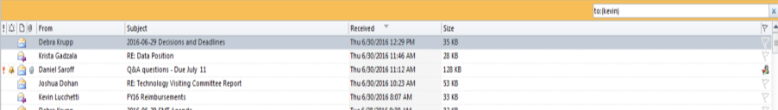
Search – Email sent to someone
Sometimes you want to find an email you sent to you a specific person.
In the Navigation Pane, click the folder that you want to search.
Select Search menu
Select Sent to button in ribbon bar
Type in a name (Kevin) in the search box, and you’ll see the emails you sent
Even simpler, type to:kevin in the search box, and you will get the same results

Slide 31
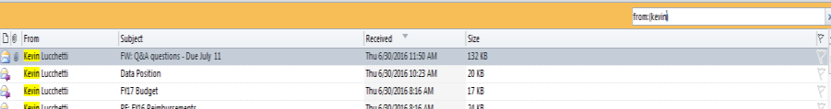
Search – Email received from someone
Sometimes you want to find emails received from a specific person.
In the Navigation Pane, click the folder that you want to search.
Select Search menu
Select From button in ribbon bar
Type in a name (Kevin) in the search box, and you’ll what they sent*
Even simpler, type from:kevin in the search box, and you will get the same results

Slide 32
Search – Key expressions
Type this | To find this
bobby | Items containing bobby, BOBBY, BoBby, or any other combination of uppercase and lowercase letters. Instant Search is not case sensitive.
bobby moore | Items containing both bobby and moore, but not necessarily in that order.
bobby AND moore | Items containing both bobby and moore, but not necessarily in that order. Note that logical operators such as AND, NOT, and OR must be in uppercase letters.
bobby NOT moore | Items containing bobby, but not moore.
bobby OR moore | Items containing bobby, moore, or both.
"bobby moore" | Items containing the exact phrase bobby moore. Note the use of double quotes so that the search results match the exact phrase within the quotes.
from:"bobby moore" | Items sent from bobby moore. Note the use of double quotes so that the search results match the exact phrase within the quotes.
from:"bobby moore" about:”status report” | Items sent from bobby moore where status report appears in the subject line, body, and attachment contents. Note the use of double quotes so that the search results match the exact phrase within the quotes.
hasattachment:yes | Items that have attachments. You can also use hasattachment:true to get the same results.
attachments:presentation.pptx | Items that have attachments named presentation.pptx or if the attachment containspresentation.pptx within its contents.
subject:"bobby moore" | Items whose subject contains the phrase bobby moore.
subject:bobby moore | Items with bobby in the subject and moore anywhere else in the document.
cc:"bobby more" | Items in which the display name bobby moore is on the Cc line.
cc:bobbymoore@contoso.com | Items in which the e-mail address bobbymoore@contoso.com is on the Cc line.
bcc:bobby | Items in which bobby is on the Bcc line.
For a full list of search expressions go to https://support.office.com/en-us/article/Learn-to-narrow-your-search-criteria-for-better-searches-in-Outlook-d824d1e9-a255-4c8a-8553-276fb895a8da

Slide 33
Scheduling and booking rooms
Communicate and work effectively

Slide 34
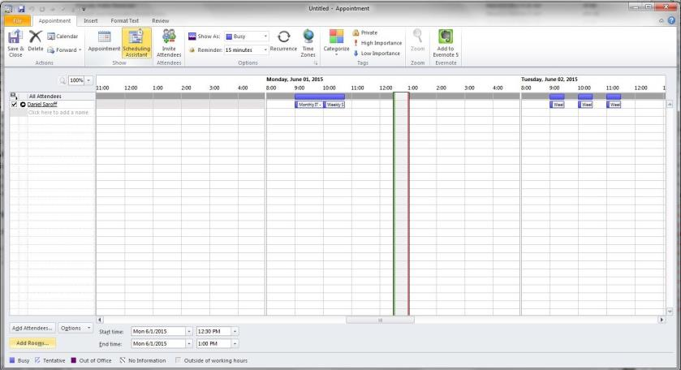
Booking a room
Create a meeting invite as normal (For instructions on booking a meeting, click this link and start at page 7)
Click Scheduling Assistant in the ribbon bar to invite attendees and add the conference room

Slide 35
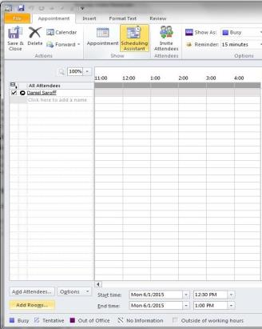
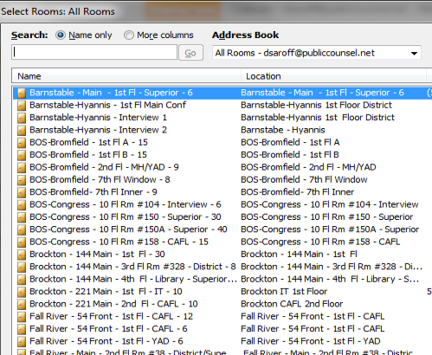
Booking a room
Add attendees
Click Add rooms button at the bottom to add a conference room
Next to Search click Name only radio button to see all rooms
There is a description of each room location, size, features, etc. Select the room you want

Slide 36
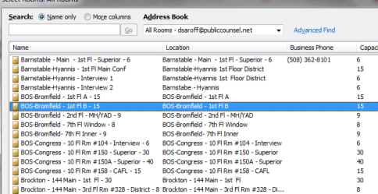
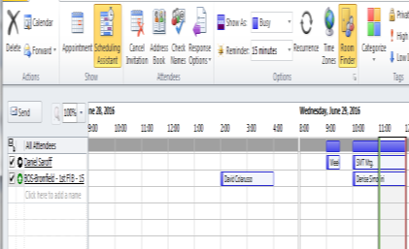
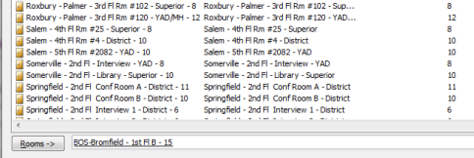
Booking a room
Double-click the room, and select OK at the bottom to select
You can see if the room is available for that time (if unavailable, it will show as a solid blue bar). If everything looks good (people and room are available), send your invitation.
Already booked

Slide 37
Booking a room
If a room is already booked, you will receive an email from the room declining the event
If you are setting up a repeating event, and the room is booked for one (or more) of the times, you will receive an email from the room declining that specific date(s)
Some rooms (like 7th floor middle Bromfield) require AA approval. In those cases, you will receive a tentative acceptance from the room, until the AA accepts the invite
If you do not get an email from the room indicating accept, decline or tentative within a few minutes of the booking, it means you didn’t book the room correctly. You should check your meeting to determine the error

