Slide 1
HR/CMS Upgrade Review
Updated Link - https://hrcms-prod.mass.gov/psp/H92PRD/?cmd=login

Slide 2
Trouble Shooting
Clear Your Browser Cache - https://www.mass.gov/guides/clear-your-browser-cache
Internet Explorer
Microsoft Edge
Firefox
Safari
Chrome
Try using a different web browser (i.e. use Chrome instead of Firefox)
Contact the Employee Self Service Center if you need to reset your password or if continue to have technical issues while accessing the site.
Tel: 617-979-8500
Email: MassHREmployeeServiceCenter@Mass.gov

Slide 3
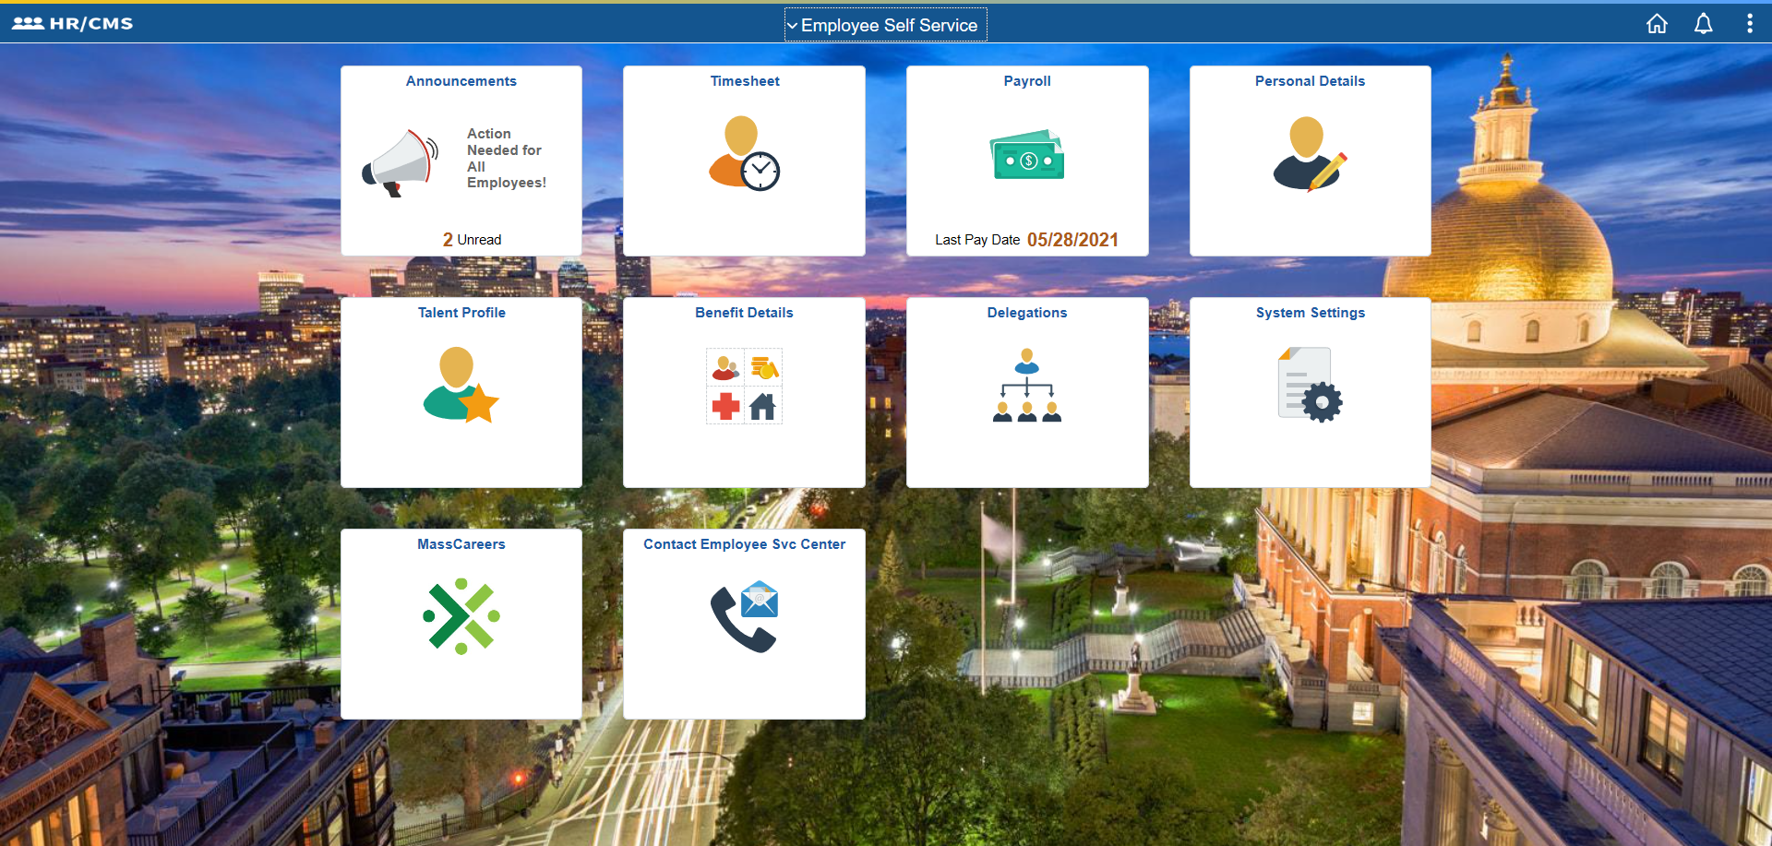

Slide 4
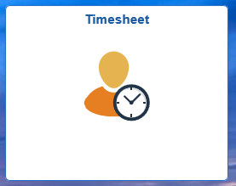
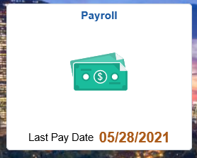
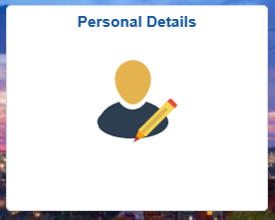

Slide 5
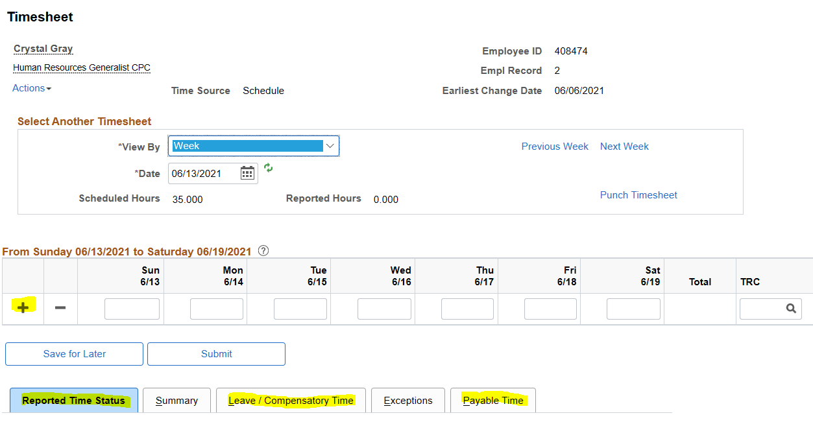
Timesheet
Submit your timesheet.
View your current sick, vacation, personal, and comp time leave balance by clicking the “Leave/Compensatory Time” tab.
View your timesheet from a previous week.
Submit your timesheet for a future week.
Can see when your time has been approved or still needs approval.

Slide 6
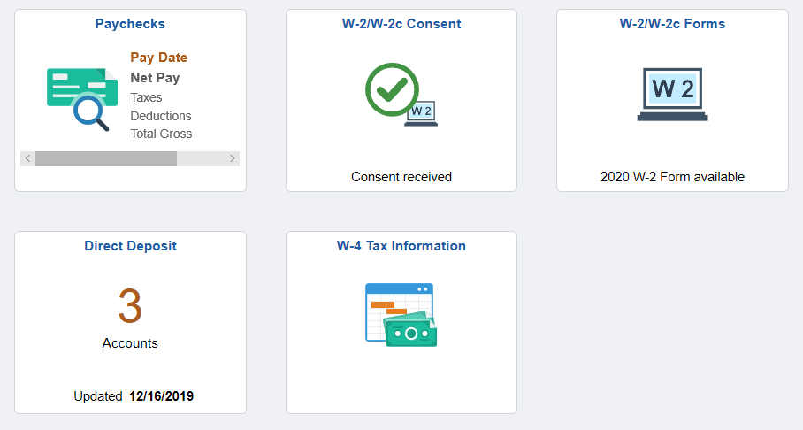
Payroll

Slide 7
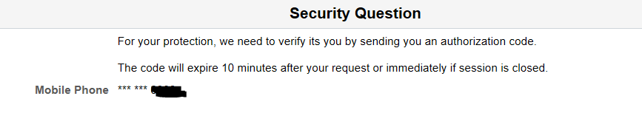
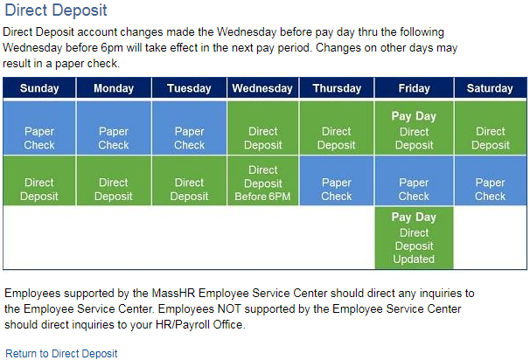
Direct Deposit
DIRECT DEPOSIT CHANGE WINDOW IS IN GREEN.
All changes must be made between the Wednesday before Pay Day and the Wednesday before the end of the current pay period to prevent a paper check from being generated, all changes will reflect in the next pay advice.
Any changes done outside of this timeframe will result in a physical check being mailed to your home address on file.
To make a direct deposit change ensure your cell number is listed in the personal summary section as a code will be sent to your phone to enter before you can proceed.
You can now make changes multiple times a day

Slide 8
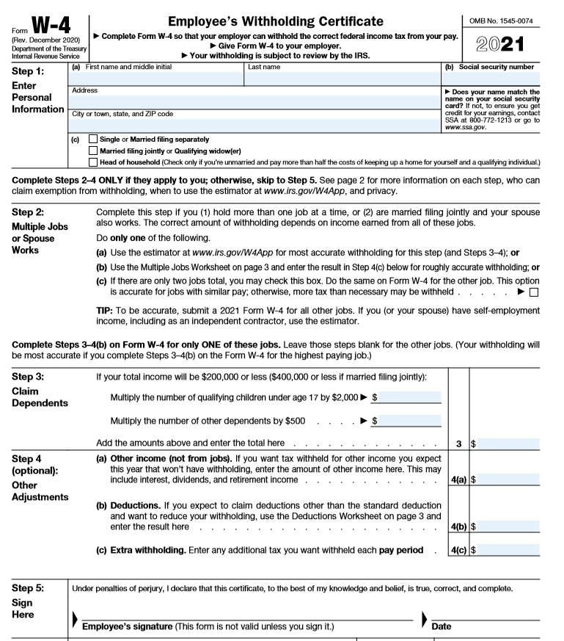
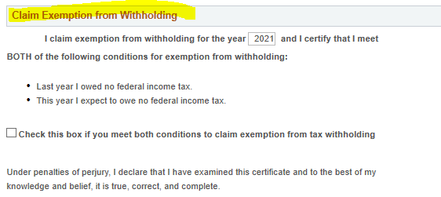
You will see that the new W-4 form will look different, the IRS removed the allowance section. The IRS changed the form due to changes in the tax law, to increase simplicity and accuracy of the form, as well as to ensure employee are having the correct amount of taxes withheld. The information you provide on the form is what will be used to calculate your taxes that will be withheld. Unfortunately, HR is unable to advise employees on what amount to withhold and it is recommended that you speak with your tax preparer or financial adviser. You may also use the IRS tax calculator to ensure you are having the right amount withheld https://www.irs.gov/individuals/tax-withholding-estimator.
For additional information on the new W-4 form you may also visit the IRS website. https://www.irs.gov/newsroom/faqs-on-the-2020-form-w-4

Slide 9
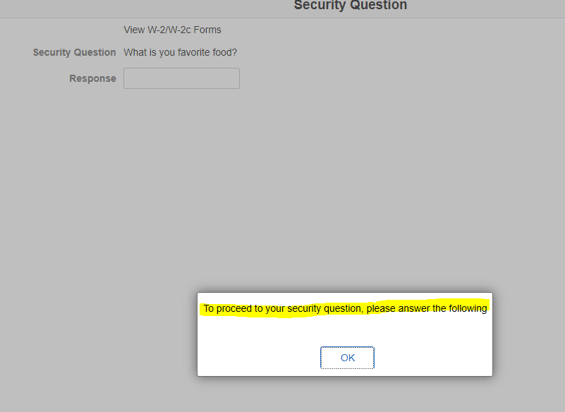
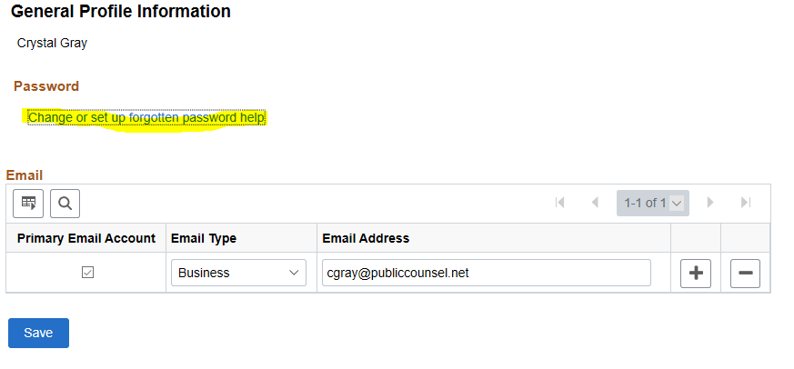
You may view/print your W-2 forms. Prior to accessing the forms you will be required to answer a security question. If you do not remember the security question you can reset it.
Select the System Security tile – General Profile Information. Follow the prompts and enter the requested information.

Slide 10
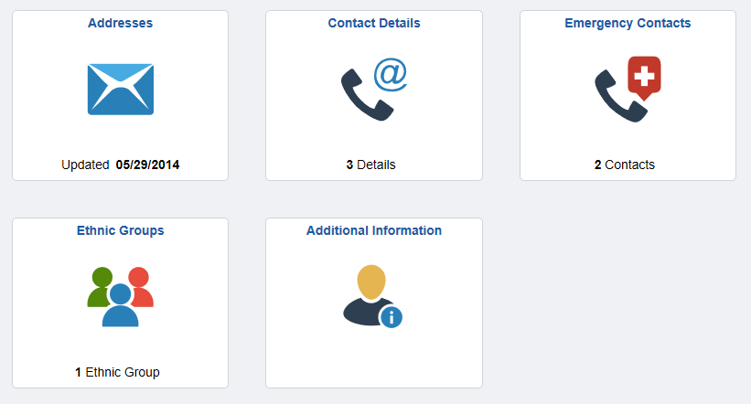
Personal Details
Active Employees can review, add or edit a Home or Mailing Address. The Home Address is printed on an employee’s pay advice and year end form W-2. The Home address is used when the annual W-2 mailings are sent out. Note: Home Address cannot be outside of the United States. Please avoid using a PO Box as the Home Address.
The Contact Details tile contains employee Phone and Email. Instant Message is not currently used.
Employees can review, add, edit, and delete emergency contact information. Employees can designate a primary emergency contact.
Employees will have access within Employee Self-Service to view, add, or update a Race or Ethnic Group. Submission of this information is voluntary and refusal to provide it will not subject you to any adverse treatment.
The Additional Information tile will display additional information in tables that are available for review only. You will be unable to update this information with Employee Self Service (i.e gender, date of birth, birth country, name change).

Slide 11
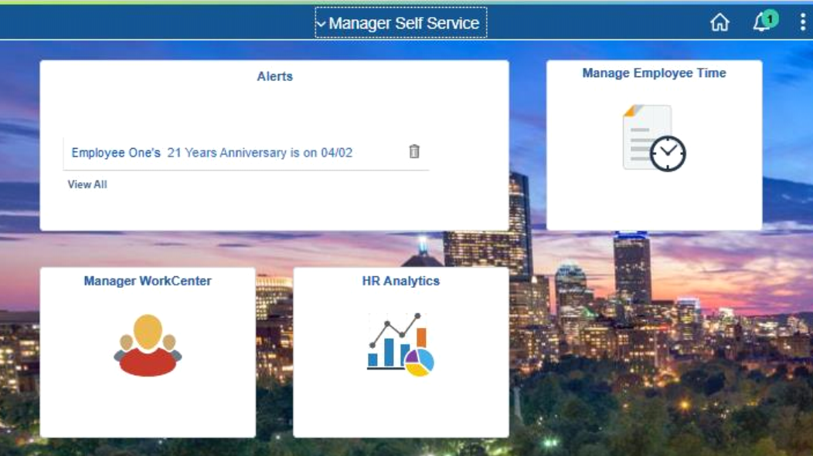
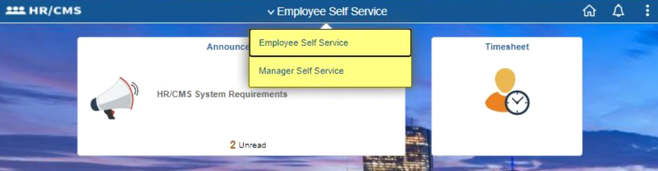
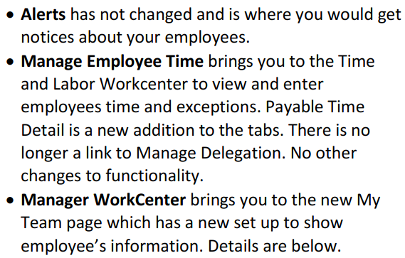
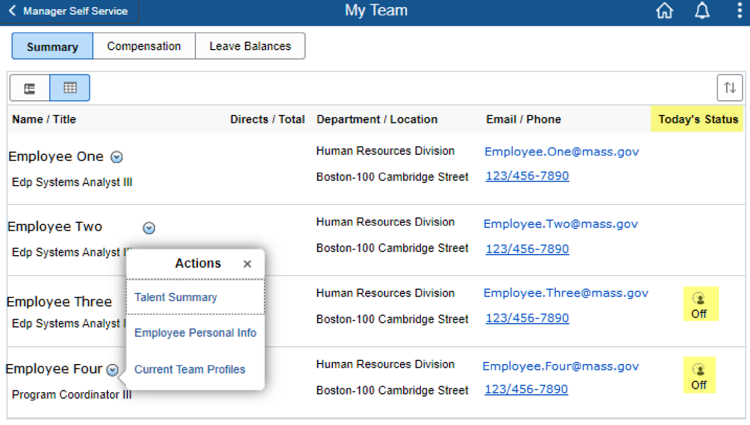
Manager Self Service

