Slide 1
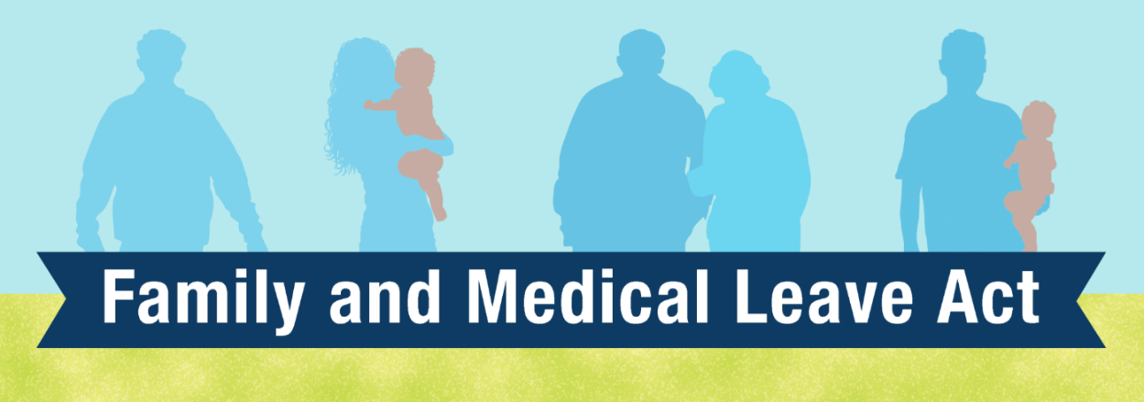




Slide 2
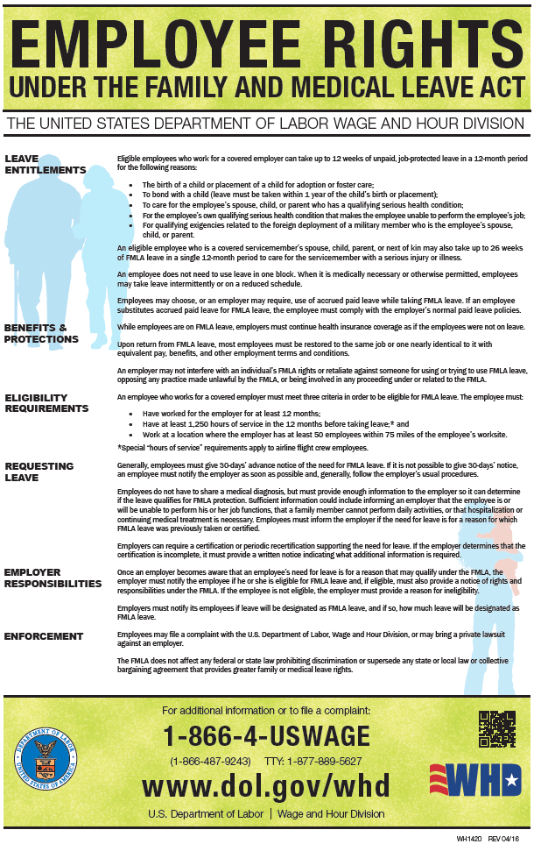

Slide 3
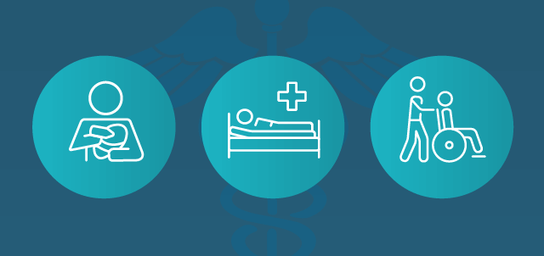
Family and Medical Leave Act
Designed to help employees balance their work and family responsibilities by allowing them to take reasonable unpaid leave for certain family and medical reasons
Leave shall only be with pay if the employee has accrued any leave credits for pay (sick, personal, vacation, and comp time)
Eligible employees may take up to 12 weeks of leave in a 12-month period
CPCS offers an enhanced FMLA Leave benefit, which allows eligible employees to take up to 26 weeks of a leave of absence

Slide 4
FMLA can be taken for the following reasons:
For the birth and care of the employee’s newborn child, must be taken within 1 year following the date of the child’s birth
For the placement of a child with the employee for adoption or foster care, must be taken within the first 12 months after adoption or foster care
For a serious illness or health condition that prevents the employee from performing the essential functions of their job
To care for the employee’s close family member or similar person with a serious illness or health condition
Any “qualifying exigency” arising out of the fact that the employee’s close family member or similar person is on active duty (or has been notified of a call or order to active duty)
To care for a covered service member with a serious injury or illness if the employee is the spouse, child, parent or next of kin of the covered service member

Slide 5
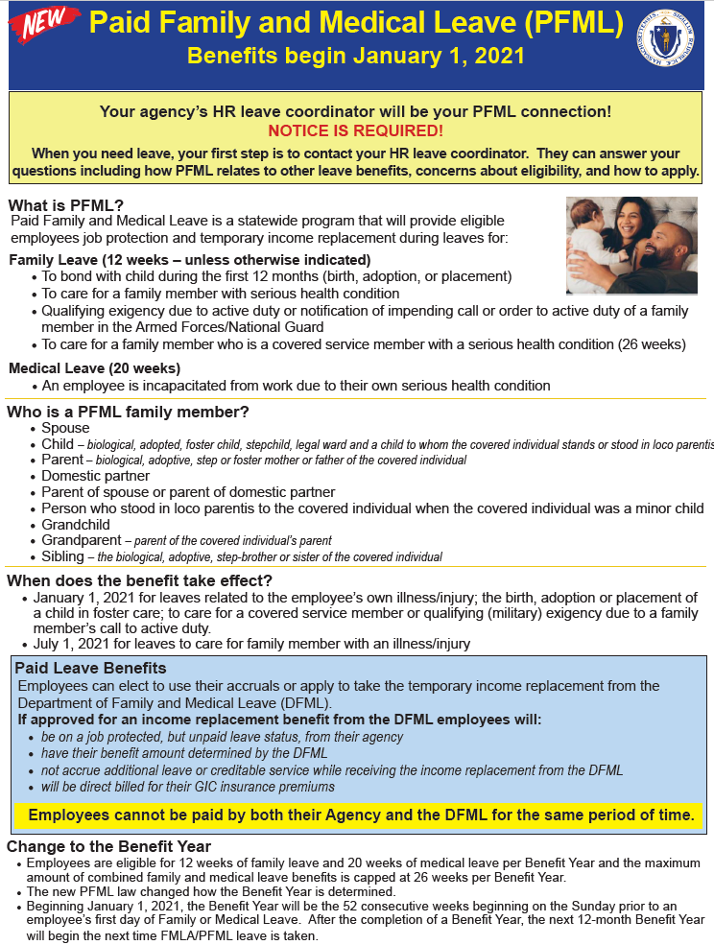

Slide 6

Paid Family and Medical Leave (“PFML”) is a new statewide program that provides eligible employees with up to 26 weeks of paid leave for family or medical reasons
Most PFML benefits became available on January 1, 2021, except for paid family medical leave to care for a family member with a serious health condition. This benefit will become available on July 1, 2021
The Department of Family and Medical Leave (DFML) oversees this program
Just like FMLA, PFML provides job protection. However, unlike FMLA, PFML provides temporary income replacement for each eligible benefit week
PFML runs concurrently with FMLA. Therefore, this new benefit does not necessarily provide employees with additional leave on top of the 26 weeks of leave that is already provided by CPCS

Slide 7
Paid family leave may be taken to:
Care for a family member with a serious health condition (July 1, 2021)
Bond with a child during the first 12 months after the child’s birth
Bond with a child during the first 12 months after adoption or foster care placement
Care for a family member who is a covered service member with a serious health condition
Manage family affairs when a family member is on or has been called to active duty while in the Armed Forces, including the National Guard or Reserves
Paid medical leave may be taken to:
Manage the employee’s own serious health condition

Slide 8
PFML Leave Benefits:
Effective January 1, 2021
Up to 20 weeks of medical leave for employee’s serious health condition
Up to 12 weeks of family leave to bond with a child or because of a qualifying exigency
Up to 26 weeks of family leave to care for a family member who is a covered service member with a serious health condition
Effective July 1, 2021
Up to 12 weeks of family medical leave to care for a family member with a serious health condition
Under PFML, employees are eligible for a combined total of 26 weeks of leave per benefit year.
12 weeks of leave to bond with their child
12 weeks to care for a family member with a serious health condition
2 weeks to care for their own serious health condition
26 weeks in a benefit year

Slide 9
PFML Paid Leave Benefits:
Unlike FMLA which is unpaid, PFML provides employees with temporary income replacement during their leave of absence. The current maximum total amount one may receive is $850 for each eligible week of leave. Benefit amount is determined by DFML and not HR.
Employees are still eligible for the 6 weeks of the CPCS Paid Parental Leave (PPL).
PFML has a waiting period of 7 calendar days before benefit payments are provided. During that week, employee may request to apply their leave credits for pay or use one of the six weeks of their CPCS PPL.
While receiving paid benefits provided by DFML, employee will be off payroll with CPCS.
    creditable years of services with the state
    accrued any leave credits (sick, vacation, or comp time)
    holiday pay
    direct billed for your share of the monthly GIC insurance premiums

Slide 10
FMLA/PFML Benefits
Leave should be taken if you need to be absent from work to take care of yourself or a family member
At the completion of your leave, you will be reinstated to the same or equivalent position with the same pay, benefits, and terms and condition of employment as prior to the start of your leave
Your health insurance coverage will continue as long as you continue to pay your share of the monthly premiums
The LOA will not affect your performance evaluation, or any opportunities for future positions, promotions, raises, and/or bonuses
Your job is protected while you are on the approved leave of absence. This means no negative employment actions (e.g., warning, suspension, or termination) will be taken against you
However, the leave does not protect you from disciplinary actions for performance or conduct not related to your leave of absence

Slide 11
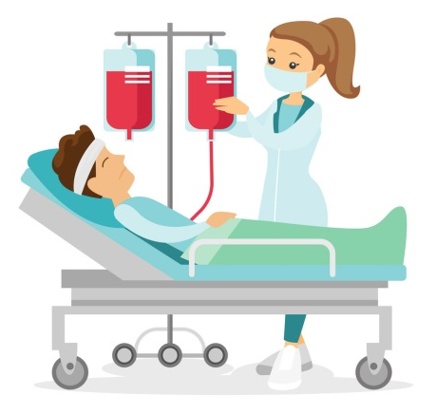




Continuous vs. Intermittent Leave
Continuous leave is taken on a full-time basis
Intermittent leave is taken on an as needed basis for medical appointments, flare-up, etc. (approved for a maximum of 6 months)
The leave also allows for a reduced work schedule
Intermittent leaves and reduced work schedules will be tracked on a 6 month basis

Slide 12
Employee’s Responsibility
Notify their manager and Human Resources when they need to take a leave of absence
Manager’s Responsibility
Notify Human Resources when an employee is absence from work for 5 or more consecutives days due to a serious illness or health condition of the employee’s or the employee’s family member
Human Resources Responsibility
Must contact the employee and notify them about their rights and benefits under FMLA and PFML
If the employee is absent from work due to one or more of the qualifying reasons that falls under FMLA/PFML, HR will designate the employee’s absence as part of their FMLA/PMFL Leave

Slide 13
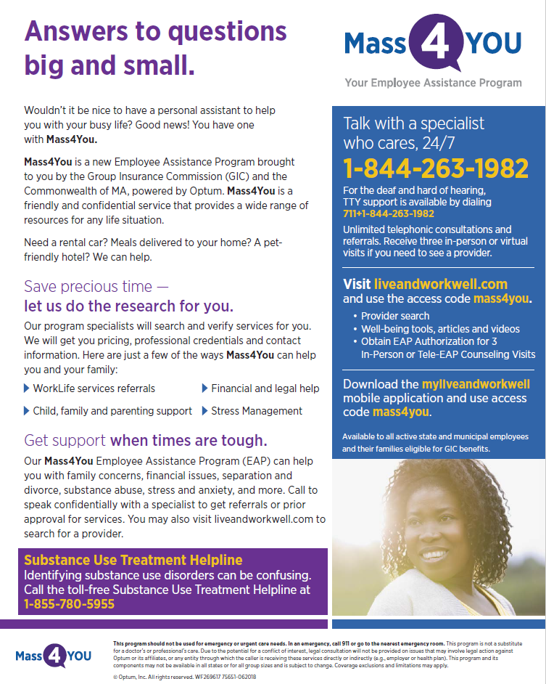

Slide 14
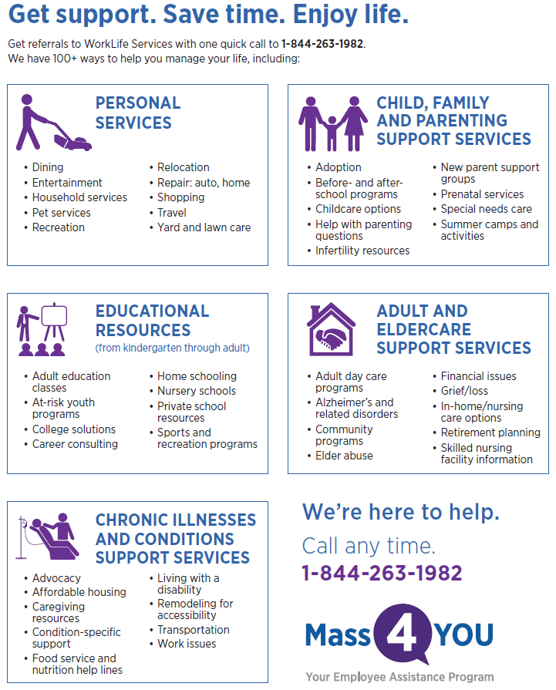
Mass4You liveandworkwell.com

Slide 15
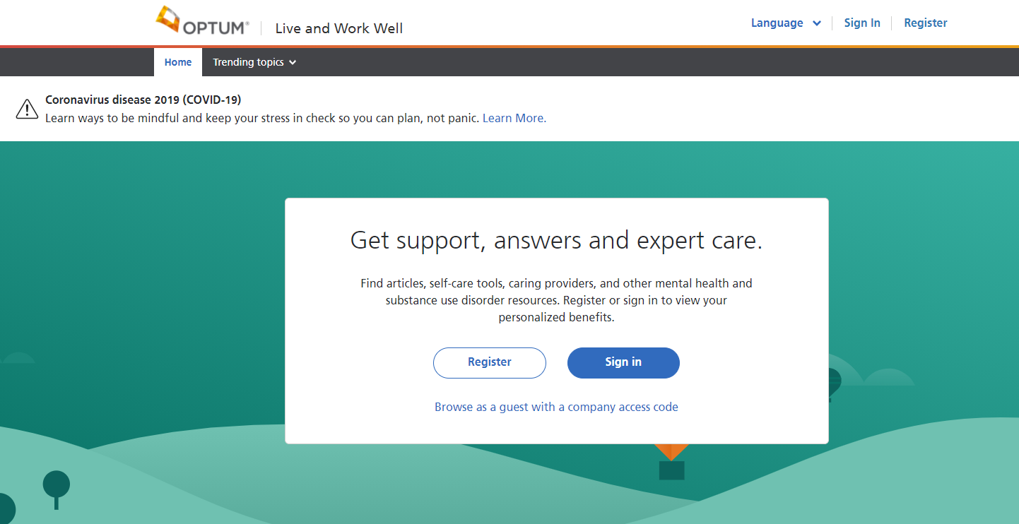
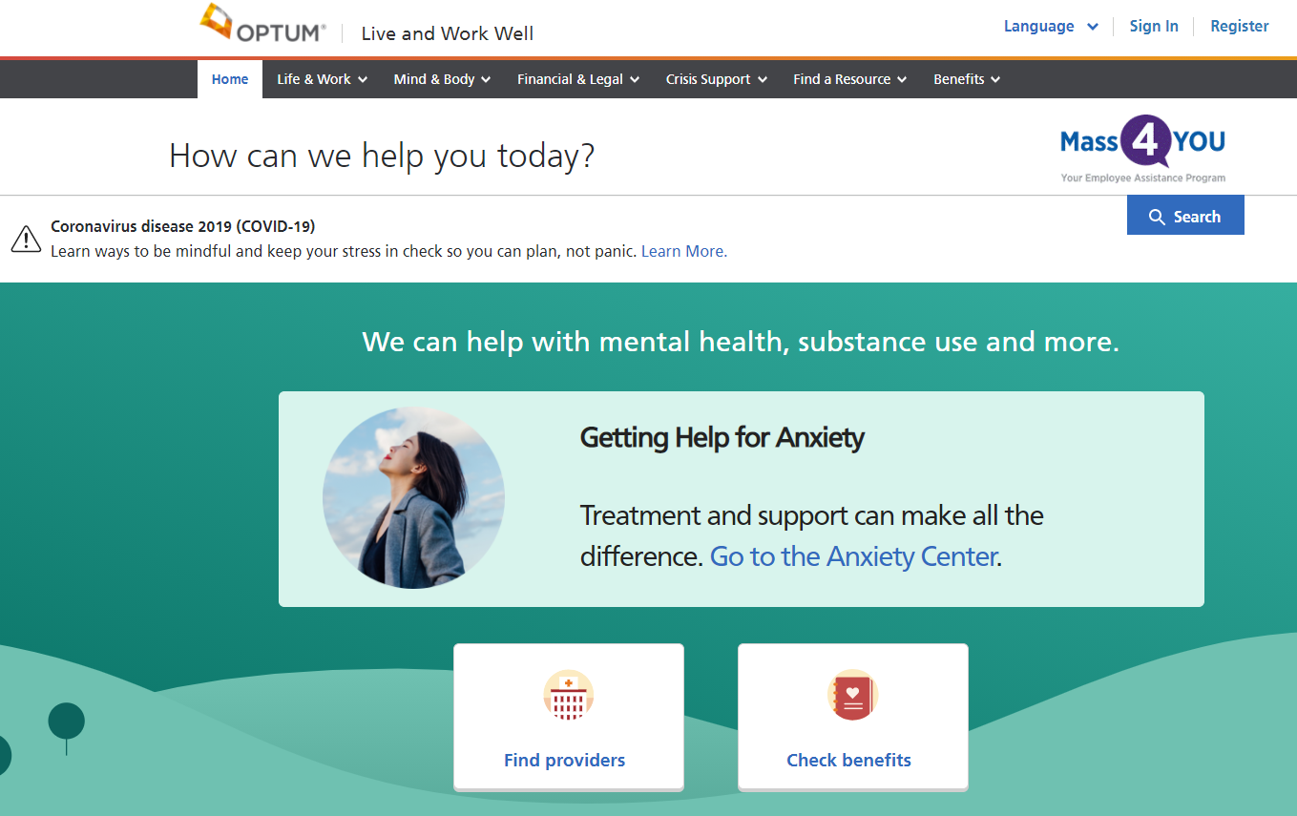
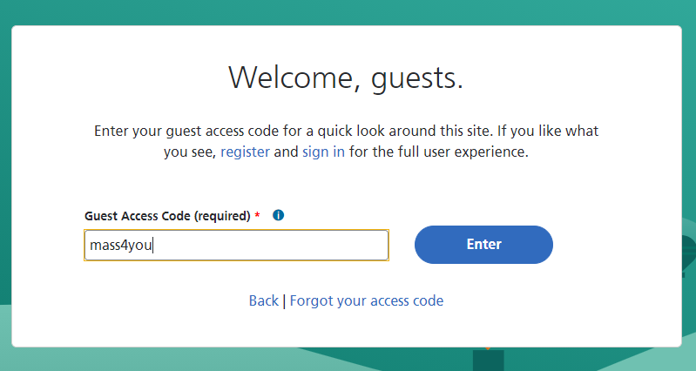

Slide 16

https://www.lclma.org/
31 Milk Street, Suite 810, Boston, MA 02109
Contact: (617) 482-9600 or (800) 525-0210
Fax: (617) 482-9909
Our Helpline Numbers are: 1-800-LCL-0210
email@lclma.org

