Slide 1

Public Service Loan Forgiveness (PSLF),Tuition Remission, and HR Intranet Overview

Slide 2
PSLF Overview
The Public Service Loan Forgiveness (PSLF) Program allows you to receive forgiveness of the remaining balance of your Direct Loans after you have made 120 qualifying monthly payments while working full time for a qualifying employer. For the purpose of the PSLF program, CPCS considers 30 hours and over to be full-time.
There is also the potential for forgiveness under the Temporary Expanded Public Service Loan Forgiveness (TEPSLF) opportunity. If some or all of the payments you made on your Direct Loans were under a non-qualifying repayment plan for PSLF, you may qualify for TEPSLF if you meet the other requirements. For more information, visit the TEPSLF information page.
To receive forgiveness, you must remain employed with a qualifying employer at the time you submit your Public Service Loan Forgiveness (PSLF) & Temporary Expanded PSLF (TEPSLF) Certification & Application AND receive forgiveness for your loans.
Moving forward, all PSLF forms will be reviewed for eligibility under the PSLF and TEPSLF programs

Slide 3
PSLF Overview…
Only certain loans qualify for PSLF/TEPSLF. If your loans don't qualify, consolidation may make them eligible.
Eligible Loan Types:
Direct Subsidized Loans
Direct Unsubsidized Loans (including TEACH Grants that were converted to Direct Unsubsidized Loans)
Direct PLUS Loans for graduate or professional students
Direct Consolidation Loans (including Special Direct Consolidation Loans)
If you do not know what type of federal loans you have, visit StudentAid.gov and find out.

Slide 4
PSLF Overview Continued…
Only certain repayment plans qualify for PSLF. To get the most benefit from the program, you should switch to an Income-Driven Repayment (IDR) plan if you're not already on one.
To benefit from PSLF, you should consider one of the following IDR plans, which generally base your loan payments on your income, family size, and loan debt.
The IDR plans are:
Revised Pay As You Earn (REPAYE)
Pay As You Earn (PAYE)
Income-Based Repayment (IBR)
Income-Contingent Repayment (ICR)
If you do not know what repayment plan you are on for your Direct Loans, visit StudentAid.gov and find out.
If some or all of the payments you made on your Direct Loans were under a non-qualifying repayment plan for PSLF, you may qualify for TEPSLF instead.
Qualifying repayment plans for TEPSLF include the qualifying repayment plans for PSLF, as well as the Graduated Repayment Plan, Extended Repayment Plan, Standard Repayment Plan for Direct Consolidation Loans, and Graduated Repayment Plan for Direct Consolidation Loans.

Slide 5
What You Need From HR…
You will need to submit page 2 of the PSLF application for HR to complete
Once completed, HR will resend the form back to you to submit to the Department of Education for their review.
*For More Information and PSLF Resources*
https://studentaid.gov/manage-loans/forgiveness-cancellation/public-service
https://myfedloan.org/borrowers/special-programs/pslf

Slide 6
Tuition Remission Overview
The Commonwealth's primary educational offering is a tuition remission program available to eligible state employees and their spouses. It provides partial to full remission of tuition for programs and courses taken on the employee's own time at public community colleges, state colleges, and state university campuses.
Employees will complete sections I-III on the form and submit it to HR to complete the remaining sections.
HR will verify eligibility and return the form to the employee to submit to their school at the time of registration.

Slide 7
Tuition Remission Eligibility and Requirements
You must be a full-time state employee, with at least six (6) months of full-time service, or equivalent part-time service, at the time you submit this certificate.
Proof of Marriage, like a Marriage Certificate, is needed if the Tuition Remission benefit is being used by your spouse. HR will verify the proof of marriage and write a description of the proof on the line provided.
The Certificate is valid for 120 days from the date of issue by your Agency Head/designee. A new certificate is required for each academic semester.
The tuition remission form can be found on the HR intranet or mass.gov website.

Slide 8
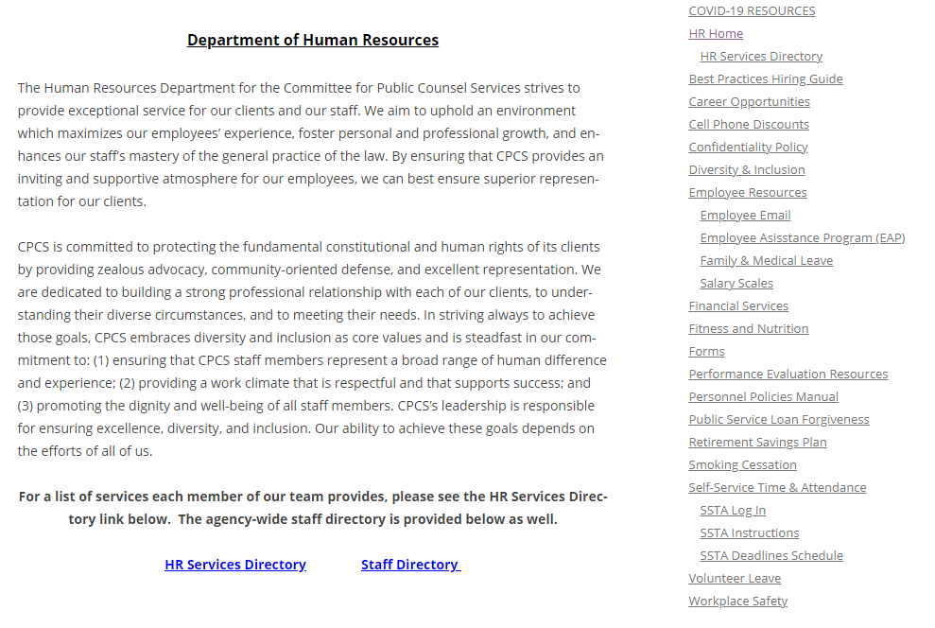
HR Intranet Overview https://intranet.publiccounsel.net/hr/

